Slide 1
Crime Victimization and Subjective Well-Being: Panel Evidence from Australia
Applied Research in Crime and Justice Conference
Sydney 16-17 February 2017
Stéphane Mahuteau, NILS & IZA
Rong Zhu, Flinders Business School

Slide 2

Aim and Background of the paper
Crime and the fear of crime is a major concern for the society (Cohen 2008).
It is so notably because:
  The costs of crime go beyond the direct, pecuniary costs such as financial losses, medical expenses, time off work etc. (see Powdthavee, 2005) and can have lasting effects on the victims. Much of the costs of crime are intangible (Leigh & Carnaglia, 2014)
  Psychological costs of crime are numerous and extend to non victims and the society as a whole (e.g. loss of well-being of non-victims living in a crime prone area; )
Since crime has a significant adverse effect on people’s well-being and society as a whole, it is important to have an accurate estimate of its effect of people’s well being (reformulate that)
Aim and background
Data
Methodology
Results
Conclusion

Slide 3
Aim and Background of the paper
There is plethora of evidence in many countries showing that experience of crime is negatively associated with various aspects of subjective well-being: e.g. Moller (2005), Powdthavee (2005), Cohen (2008), Davies & Hinks (2010), Kuroki (2013) Hanslmaier (2013)…
Some limitations in this evidence:
  Many use cross section data
  Many do not distinguish between crimes involving physical violence and crimes against property
  None of the existing studies have looked at the effects of victimization along the distribution of well-being
  We try to fill this gap using Australian data
Aim and background
Data
Methodology
Results
Conclusion

Slide 4
DATA
We use the 11 first waves of HILDA (2002-2012) where crime victimization information is available
Focus on people aged 21 to 65
Final sample includes 96,503 observations (18,460 people)
People report major events in their life in past 12 months, including being victim of a crime:
    Victim of physical violence
    Victim of property crime
1,503 events of physical violence reported, involving 1,077 individuals. 266 reported multiple instances in the period 2002-12
4,735 events of property crime, involving 3,489 individuals. 900 report property crime more than once
20% of people reporting physical violence were also victims of property crime in the same year.
Aim and background
Data
Methodology
Results
Conclusion

Slide 5
DATA: Measures of well-being
Main measure: 36 item Short Form Health Survey (SF-36)
HILDA elicits all 36 questions about physical and mental well-being
14 questions in the category of mental well-being divided into 4 scales:
  Vitality (VT): fatigue, energy scales
  Social Functioning (SF): measuring social limitations
  Role Emotional (RE): limitation in work/activities due to emotional health
  Mental Health (MH): feeling of anxiety and depression
Our main measure averages all 4 components (used in literature, see Flatau et al. 2000; Frijters et al. 2014)
We also use Life Satisfaction variable as an alternative measure of well-being.
Aim and background
Data
Methodology
Results
Conclusion

Slide 6
DATA: descriptives
Crime victims report significantly lower levels of subjective well-being than non-victims
The difference is larger for victims of physical violence
Victims are younger and less likely to be married
Victims have lower household income and slightly smaller family size
Noticeable differences in individual characteristics between victims of the 2 types of crime
  Victims of physical violence are younger than victims of property crimes
  They are less educated and have lower household income
Besides averages we can look at whether differences between victims and non victims differ along the distribution of well-being
Aim and background
Data
Methodology
Results
Conclusion

Slide 7
Kernel density estimates of mental well-being
Aim and background
Data
Methodology
Results
Conclusion
K-S test rejects the hypothesis that the reported well-being of victims vs. non-victims comes from the same distribution for both types of crime

Slide 8
SF-36 mental well-being by percentile
Gaps between victims and non-victims at each percentile are not constant
Aim and background
Data
Methodology
Results
Conclusion
Preliminary evidence that effects of victimization on well-being may be heterogeneous with larger effects in the lower half of the well-being distribution

Slide 9
Methodology
Background and aim
Data
Methodology
  FE estimation of SWB
  QR-FE estimation along SWB distribution
Results
Conclusion
Subject well-being equation
  includes age, age square, marital status, years of schooling, hh income, family size, …, state of residence, years
  We estimate the equation with FE estimator (within) and get estimates of β₁ and β₂ and compare with OLS estimations
  This gives us the mean effects of the two types of crime on subjective well-being
  The second part of the methodology looks at these effects along the distribution of well-being
Physical violence
Property crime
Individual characteristics
Unobserved individual heterogeneity

Slide 10
Methodology
Background and aim
Data
Methodology
  FE estimation of SWB
  QR-FE estimation along SWB distribution
Results
Conclusion
  Panel data quantile regression with FE (QR-FE) (2 stages, Canay 2011)
  Step 1: estimate the unobserved FE as
  Step2: standard conditional quantile regression (Koenker & Basset, 1978) with the dependent variable as:
  The estimated effects of victimization at the τ^{th} percentile of the distribution of SWB is given by the betas.

Slide 11
Estimation results: Mean effects of victimization
Background and aim
Data
Methodology
Results
  Mean effects of victimization
  Effect along the SWB distribution
  Compare with other life events
  alternative measures of SWB / robustness check
Conclusion
Mean effects of victimization on subjective well-being
  On average physical violence associated with decline by0.3 std deviation (0.566/1.90) (FE estimates, after control for unobserved heterogeneity, 0.81 in OLS results)
  FE estimates show no significant gender differences for both crimes
  Property crimes: average decline of 0.03 std. dev. in the FE estimates (0.21 with OLS). Mean effect much smaller with property crime
 | All | Male | Female | H_{o}: Male=Female
OLS estimates
Physical violence | -1.537*** | -1.231*** | -1.776*** | p=0.000
 | (0.081) | (0.109) | (0.111)
Property crime | -0.397*** | -0.397*** | -0.416*** | p=0.790
 | (0.036) | (0.050) | (0.051)
FE estimates
Physical violence | -0.566*** | -0.485*** | -0.637*** | p=0.193
 | (0.059) | (0.079) | (0.086)
Property crime | -0.066*** | -0.054* | -0.078** | p=0.603
 | (0.023) | (0.030) | (0.035)

Slide 12
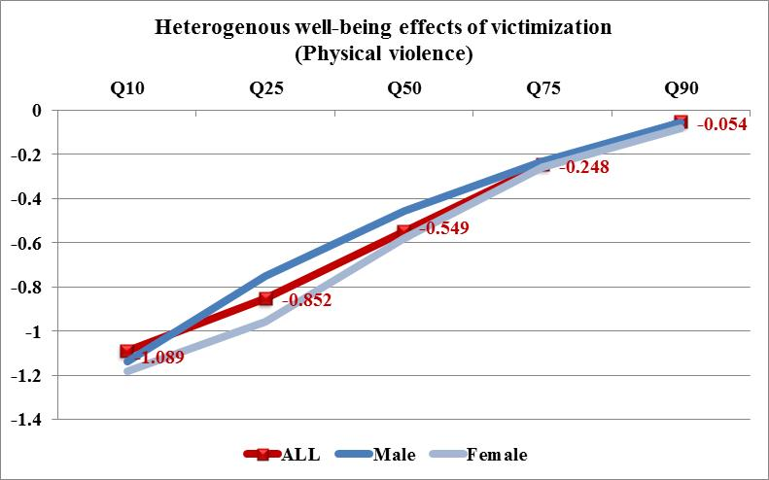
Estimation results: QR estimates
Effects of crime victimization on subjective well-being along the distribution of well-being: Physical violence
  Physical violence has twice the negative impact at the 10th percentile of SWB compared to the average while the effect is not significant at the 90th.
  Largest effects at the bottom part of the distribution, monotonically decreasing along the distribution.
  → average effects conceal a large heterogeneity over the SWB distrib
Background and aim
Data
Methodology
Results
  Mean effects of victimization
  Effect along the SWB distribution
  Compare with other life events
  alternative measures of SWB/ robustness check
Conclusion

Slide 13
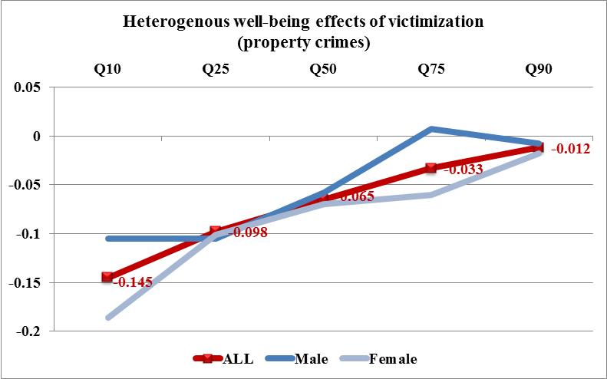
Estimation results: QR estimates
Effects of crime victimization on subjective well-being along the distribution of well-being: Property crime
We find the same type of results for property crimes, with much smaller magnitude
Background and aim
Data
Methodology
Results
  Mean effects of victimization
  Effect along the SWB distribution
  Compare with other life events
  alternative measures of SWB/ robustness check
Conclusion

Slide 14
Estimation results: components of SF 36 well being
Background and aim
Data
Methodology
Results
  Mean effects of victimization
  Effect along the SWB distribution
  Compare with other life events
  alternative measures of SWB/ robustness check
Conclusion
We conduct the same estimations for each components of the SF-36 measures
Social functioning and Role Emotional are more strongly affected by both crimes and display more heterogeneity along the distribution of SWB.
The other components are significantly negatively affected by the experience of physical violence. Less so by property crimes (still significant though)
The other components of well-being display less heterogeneity
(especially with property crimes).
Illustration →

Slide 15
Estimation results: components of SF 36 well being
Background and aim
Data
Methodology
Results
  Mean effects of victimization
  Effect along the SWB distribution
  Compare with other life events
  alternative measures of SWB/ robustness check
Conclusion

Slide 16
Estimation results: Comparison with other life events
We compare the results of crime on subjective well being with other life events using same techniques:
  Serious personal injury/illness (7.8% of observations)
  Fired or made redundant (3.4% of obs.)
  Death of spouse or child (0.59% of obs.)
All these events have a negative effect on well-being, which also display large heterogeneity across the SWB distribution.
We find that the effects of property crimes are significantly smaller than the effects of all other life events
We find that the well-being losses of people who have experienced physical violence are smaller in magnitude to having suffered a serious personal injury or the death of a spouse or child.
However, the well-being losses from physical violence are about three times as large as the losses from being fired/made redundant
Background and aim
PISA data
Methodology
Results
  Mean effects of victimization
  Effect along the SWB distribution
  Compare with other life events
  alternative measures of SWB
Conclusion

Slide 17
Estimation results: Comparison with other life events
Background and aim
Data
Methodology
Results
  Mean effects of victimization
  Effect along the SWB distribution
  Compare with other life events
  alternative measures of SWB
Conclusion

Slide 18
Estimation results: Robustness checks
Background and aim
Data
Methodology
Results
  Mean effects of victimization
  Effect along the SWB distribution
  Compare with other life events
  alternative measures of SWB/ robustness check
Conclusion
We tested whether sample attrition may have led to some biases in our estimates: Victims of crimes may be more likely to attrite and may also be those who have had the largest impact of crime on well-being.
  Literature using HILDA finds large random component to non response in HILDA (Watson & Wooden 2006, 2007; Cai & Waddoups, 2011)
  Own calculations: crime victims are not more likely to attrite from the sample than non-victims
Rerun the estimations with an alternative measure of well-being: Life satisfaction and satisfaction with safety
  has been used in literature as measure of SWB (Clark et al. 2008; Kuroki, 2013, Staubli et al., 2014…)
  We use both measures above to rerun the estimations.
  We find similar results than those with SF-36

Slide 19
Estimation results: Robustness checks
Did people experience a decline in their SWB before victimization?
Our technique addresses the endogeneity bias arising from unobserved individual heterogeneity.
It does not address the bias due to the possible reverse causality between crime victimization and SWB.
If individuals who have experienced a shock of well-being are more likely to become victims of a crime then we may have overestimated the negative effect of crime on SWB
We use the approach developed by Clark et al. (2008) to test whether there is decline in SWB prior to victimization.
Using this approach we find no evidence that people SWB becomes significantly lower before victimization. (this corroborates earlier speculations by Powdthavee, 2005; Davies & Hinks 2010….)
Our dynamic model also shows that the effect of crime victimization is transitory, well-being returns to its pre victimization level after a year of the event as are all other life events (Clark et al. 2008). People adapt to their circumstances.
Background and aim
Data
Methodology
Results
  Mean effects of victimization
  Effect along the SWB distribution
  Compare with other life events
  alternative measures of SWB/ robustness check
Conclusion

Slide 20
Conclusion
  We find that both physical violence and property crimes negatively affect the subjective well-being of Australians
  The average effect is stronger for physical violence by a magnitude of 0.3 standard deviation of the well-being measure (0.03 for property crimes)
  We find strong evidence of heterogeneity of the effect of crime along the distribution of well being:
  For physical violence, people at the lower end of the distribution experience a negative effect on their well-being that is twice as much as the average effect
  Those at the higher end of the distribution experience a very small effect of crime on their well-being
  Comparing to other life events, physical violence leads to lower losses in well-being than suffering from severe personal injury or experiencing the death of a spouse or a child
  But the effect is much larger than that of losing one’s job
Background and aim
PISA data
Methodology
Results
Conclusion

Slide 21
Conclusion
Background and aim
PISA data
Methodology
Results
Conclusion
Thank you ….

