Slide 1
Psychosis and offending behaviour in New South Wales –a population level data-linkage study
Nabila Chowdhury
Tony Butler
Justice Health Research Program
School of Population Health
Notes:
Presentation not meant to stigmatise the mentally ill.

Slide 2
Acknowledgements
A/Professor Stephen Allnutt – Conjoint Lecturer, UNSW Psychiatry
A/Professor Handan Wand - Kirby Institute, UNSW Australia
Dr Azar Kariminia - Kirby Institute, UNSW Australia
Dr Armita Adily - Kirby Institute, UNSW Australia
Professor Peter Schofield - Hunter New England Local Health District
Dale Owens – Justice Health & Forensic Mental Health Network
Luke Grant - Corrective Services NSW
Professor James Ogloff - Swinburne University of Technology
Dr Grant Sara - NSW Ministry of Health
Dr Elizabeth Moore - NSW Ministry of Health
A/Professor Don Weatherburn - NSW Bureau of Crime Statistics and Research
Colman O’Driscoll - Medibank
Professor David Greenberg AM - Justice Health & Forensic Mental Health Network
Professor Malcolm Hudson – Macquarie University
Dr Olayan Albalawi –University of Saudi Arabia
Dr Erin Spike- Kirby Institute, UNSW Australia

Slide 3
Presentation
First Psychosis data linkage study – commenced in 2016
Updated data linkage study (2001-2020)
Association between psychosis and offending behaviour
Recency of diagnosis of psychosis and prison episodes for most recent year (2019-2020)
Prison EQUIPS programs, alerts and self-harm inside prison
Post release reoffending
Role of social housing in post-release contact with community mental health services
Mortality in the cohort
Future research based on these data

Slide 4
Psychosis
Psychosis is a chronic relapsing mental illness characterised by a loss of contact with reality including hallucinations and delusions.
Considered to be a risk factor for criminal offending, including violent offending
References of papers on offending by psychotic
Prevalence higher in prison samples (Odds Ratio = 11.2; Butler & Allnutt 2006)

Slide 5
Key findings from the first Psychosis data linkage study (2001-2015)
Association with offending established
Cases were 5 times more likely to have a conviction for offending compared to controls
Cases - 10% of all offences committed in NSW between 2001 and 2015.
Similar offending profiles
Diversion (Section 32/33 Mental Health Act)
Only 26% of those with a prior diagnosis of psychosis received a treatment order
Treatment orders were 50% lower in Aboriginal citizens.
Re-offending 12% lower in those with psychosis who received a treatment order versus a punitive sanction.
Treatment
Increased contact with community mental health services significantly reduced the odds of reoffending (5x greater in those with no clinical contact versus those with the most contact).
Early treatment (within 30 days of index offence) reduced the chance of reoffending by 30%.

Slide 6
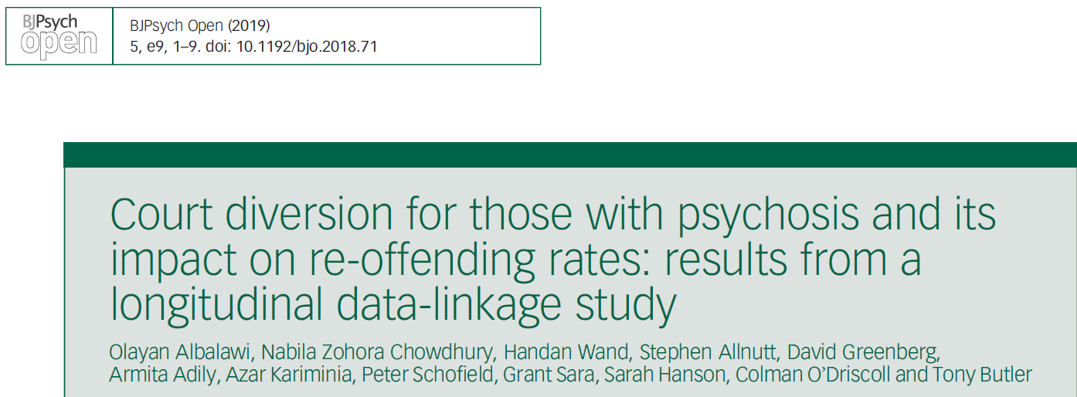
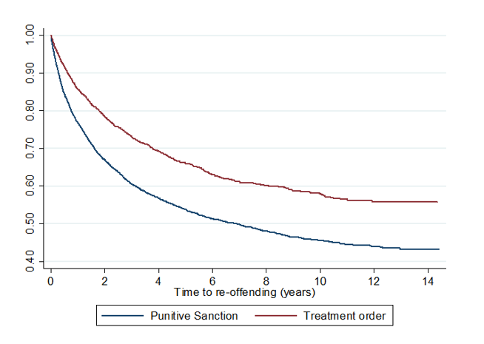
Kaplan-Meier curves for treatment order versus punitive sanction on re-offending

Slide 7
Updated Data-linkage study (2001-2020)

Slide 8
Data collections
NSW Admitted Patient Data Collection (APDC)
NSW Emergency Department Data Collection (EDDC)
NSW Mental Health Ambulatory Data Collection (MH-AMB)
Mental Health Outcomes and Assessment Tool Collection (MH-OAT)
NSW Bureau of Crime Statistics and Research Reoffending Database (ROD)
NSW Offender Integrated Management System (OIMS)*
The NSW Registry of Births, Deaths and Marriages (RBDM) death registrations
Australian Bureau of Statistics (ABS) mortality dataset
NSW Controlled Drugs Data Collection (CoDDaC) (NEW)
Housing Operations Management and Extended Services Database (HOMES) - NSW Dept. of Communities & Justice (NEW)
Client Information Management System (CIMS) NSW Dept. of Communities & Justice (NEW)
Child Protection database from NSW Dept. of Communities & Justice (NEW)
Out of Home Care database from NSW Dept. of Communities & Justice (NEW)
NSW Mental Health Review Tribunal database (NEW)
* For this study, we received some additional datasets associated with the NSW Offender Integrated Management System (OIMS) along with the custody episodes data i.e., alerts, prisoner movements, in prison programs, self-harm records, LSI-R and ISQ datasets.

Slide 9
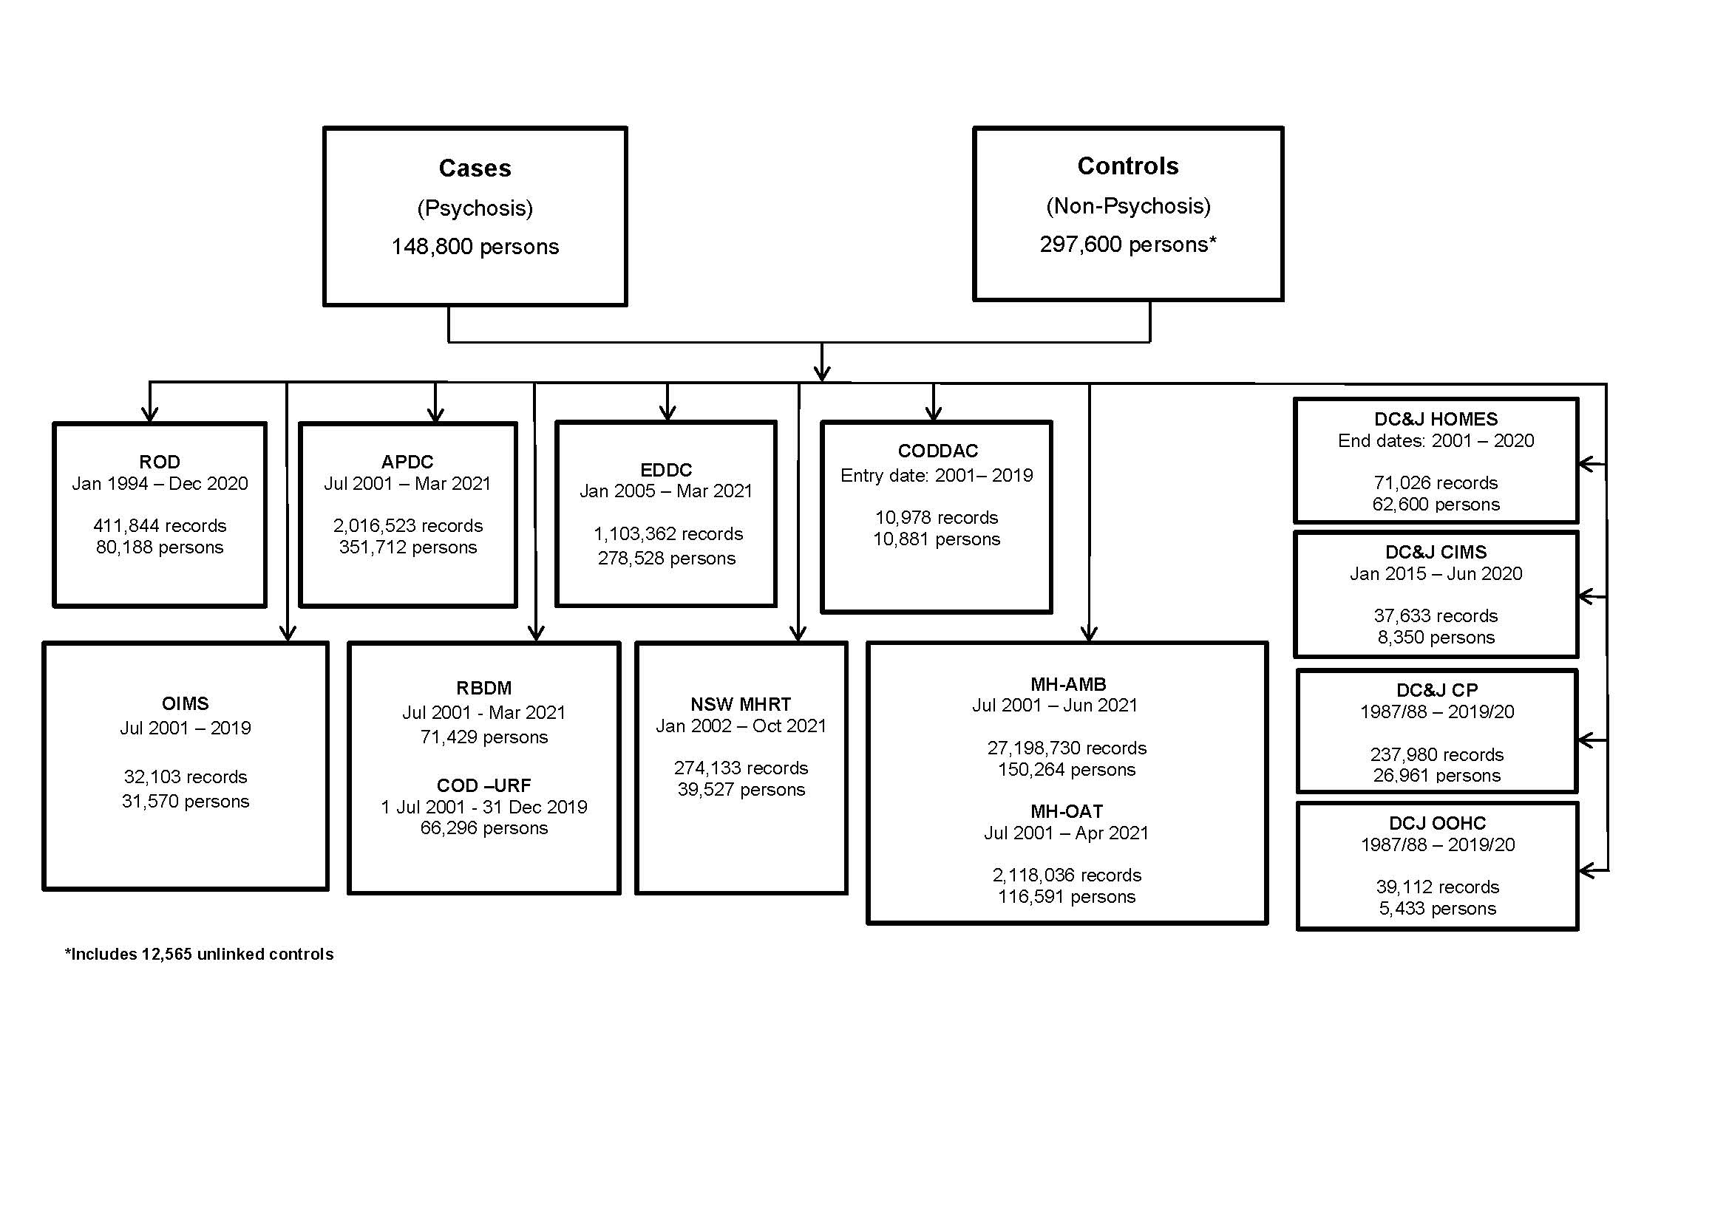
Linkage schema (2001-2020 Cohort)

Slide 10
The Cohort

Slide 11
Cohort definition
Cases: All individuals in NSW diagnosed with psychosis on admission for a hospital episode (APDC), or emergency department (EDDC) between 2001 and 2020, regardless of age (n = 143,506)
Controls: For each case, two controls without any record of a diagnosis of psychosis during the study period matched by birth year and sex identified from the CHeReL Master Linkage Key¹ (n = 270,848)
Focussed on three types of psychosis based on ICD codes:
Schizophrenia and related psychoses
Affective psychoses
Substance-related psychoses
¹ Contains around 151 million records of 13 million people and was constructed by the Centre for Health Record Linkage (CHeReL)

Slide 12
Characteristics of the study population
Median age of individuals with psychosis was 44 years (IQR: 31-62) at the time of their most recent diagnosis and for controls 46 years (IQR:32-66)
55% of the study population men
6.2% individuals with psychosis were identified as being of Aboriginal heritage compared with 1.7% of controls
Cases were more likely to be from disadvantaged areas according to the SEIFA (51.7% vs. 44.3%, p<0.001)

Slide 13
Recency of psychosis diagnosis

Slide 14
Recency of diagnosis of psychosis by year & lifetime diagnosis (all cases) – July 2001-June 2020

Slide 15
Recency of psychosis diagnosis
32.7% had their most recent diagnosis over a decade ago (i.e., cumulative percentages from 2001-2009), 11.5% in 2019-2020, and 8.4% in 2018-2019 etc. Lag between the most recent diagnosis for a treatment episode and incarceration episode may give an indication of current treatment burden of the prisoner population.

Slide 16
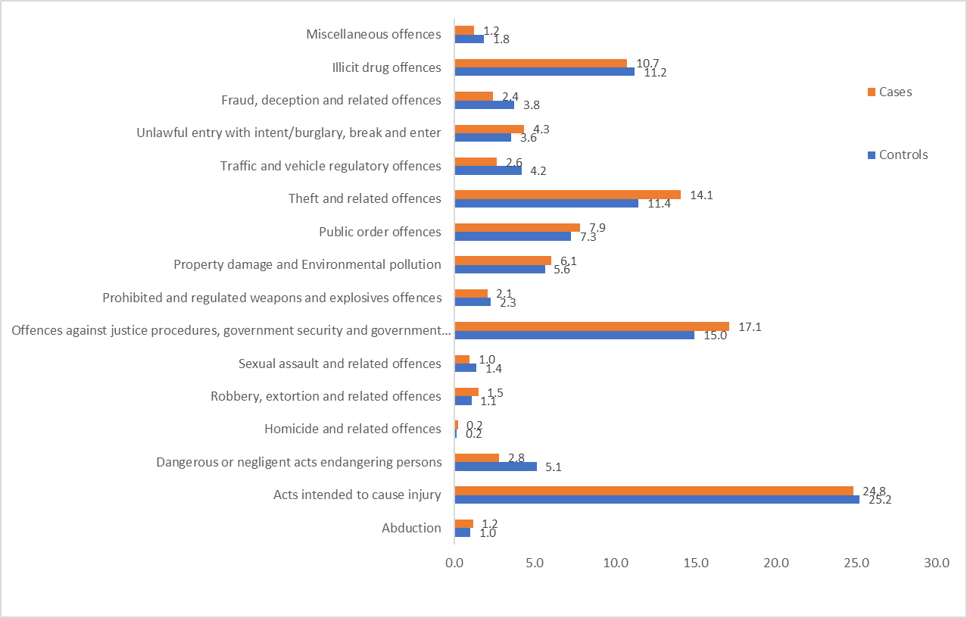
Offending behaviour
Proportion of offences committed by individuals with psychosis (overall) and controls – July 2001-June 2020
Almost one-third of psychosis cases (32.9%) and 6.9% of controls had been convicted of an offence between July 2001 and June 2020
Convictions were highest in those with substance-related psychoses across most offence categories.
More than one fifth of the cases (22.2%) and 3.6% of the controls had a conviction for a violent offence
The median number of convictions among cases was 10 versus 4 for controls

Slide 17
Prison Episodes

Slide 18
Prison episodes (2001-2020)
Overall, 14,900 (10.4%) cases and 2,713 (1%) controls were incarcerated at least once between 2001 and 2020
21.6% cases were Aboriginal vs. 18.0% of controls.
Among cases who were incarcerated
18.6% had their most recent prison episode in 2019-2020

Slide 19
Recency of diagnosis of psychosis and prison episodes for most recent year (2019-2020)
991 of 2,779 (35.7%) cases had their most recent diagnosis of psychosis in 2019-2020 and also a prison episode during this time period.
A further 239 had a recent diagnosis of psychosis in 2017-2018 and 455 in 2018-2019
Thus, we estimate that somewhere between 5% and 8.8% of the total prisoner population have had a recent (past 3 years) diagnosis of psychosis (considering the total prisoner population of 19,089 in 2019 According to the Australian Bureau of Statistics).

Slide 20
Self-harm in Prison

Slide 21
Self-harm incidents in prison
Overall, 15.0% of cases who went to prison self-harmed inside prison vs. 3.6% of controls
Those with a diagnosis of schizophrenia and related psychoses were 5 times more likely than the controls to have self-harmed in prison.
Similarly, those with affective psychoses and substance-related psychoses were also more likely to self-harm
Men less likely than women to self-harm
Aboriginal people more likely to self-harm
Older individuals less likely than those under 25 years to self-harm

Slide 22
Adjusted* odds ratios for self-harm in prison- 2001-2020
* Adjusted by psychosis type, age, sex, and Aboriginality

Slide 23
Prison alerts and self-harm
Study population
11,344 cases (had a prior diagnosis before prison episode) and 2,680 controls
Alerts during prison episodes
2,066 (18.2%) cases 2,808 alert records
70.1% alerts were mandatory alerts followed by 27.4% alerts for a history of mental illness

Slide 24
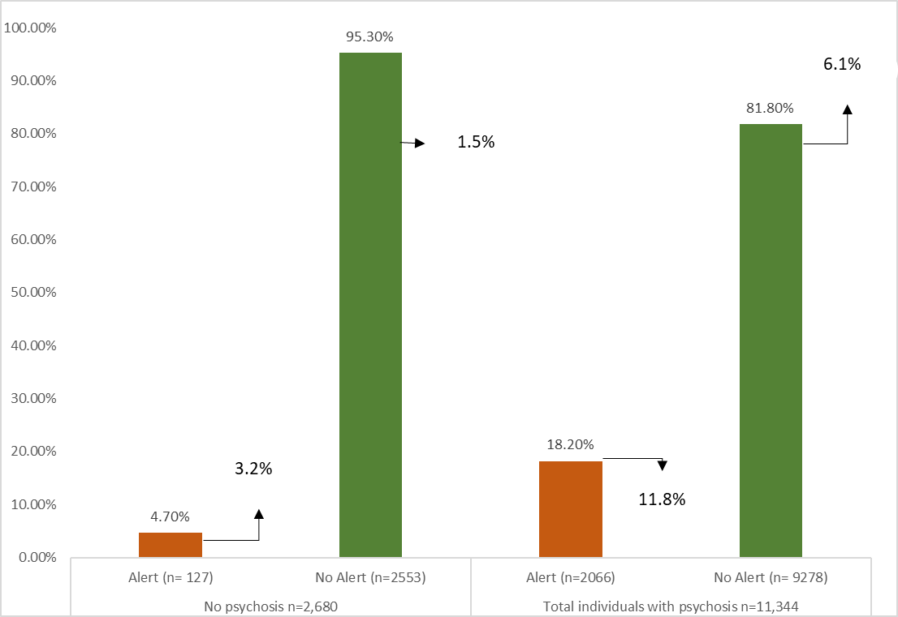

Slide 25
Prison Programs

Slide 26
Prison programs
CSNSW delivers programs including the Explore, Question, Understand, Investigate, Practice, Succeed (EQUIPS) suite of programs:
EQUIPS Foundation program
EQUIPS Aggression program
EQUIPS Addiction program
EQUIPS Domestic Violence program
Intensive Drug and Alcohol Treatment Program
Sex Offender Treatment program
Violent Offender Treatment program
Education program
2,882 (19.5%) cases commenced or completed at least one program vs. 459 (17.1%) controls

Slide 27
Programs commenced vs. completed in cases (n=14,769) and controls (n=2,680) –2001 - 2020

Slide 28
Post-release reoffending

Slide 29
Findings
11,720 cases and 2,109 controls were selected who were released from prison (2001-2018)
These individuals were followed-up until their first occurrence of an offence or death or completion of the study period at the end of June 2020
The median follow-up time was 4.5 years (IQR: 2.2-8.6)
66.8% of cases reoffended vs. 59.5% of controls (2001-2020)

Slide 30
Adjusted* hazard ratios for reoffending in prisoners with psychosis released from prison up to June 2018 and followed-up until 2020
* Adjusted for psychosis type, Aboriginality, sex, age, and marital status.

Slide 31
Social Housing following release from prison and contact with community mental health services

Slide 32
Housing database
Housed applicants by social housing support
Applicants on waiting list to get social housing
Housed applicants by other providers
75.3% cases had contact with community mental health services vs. 26.9% of controls

Slide 33
Relationship between stable housing and post-release contact with community mental health services
Multivariate logistic regression models were used
Reference group- those with no housing record
Housed applicants by social housing support (n=1,663; 14.2%) were approximately 3 times more likely to have mental health service contact in the community.
Applicants on waiting list (n=1,284; 11.0%) were approximately 2 times more likely to have mental health service contact in the community.
Housed applicants by other providers (n=210; 1.8%) were approximately 3 times more likely to have mental health service contact in the community.

Slide 34
Adjusted odds of having post-release contact with community mental health services in released prisoners with a prior diagnosis of psychosis (released up to June 2018 and followed up until 2020)

Slide 35
Mortality in the cohort

Slide 36
Results
22.56% (n = 30,838) cases died vs. 11.48% controls (n = 31,819) died between July 2001 to June 2019
schizophrenia and related psychoses (25.5%; n = 26,056); affective psychoses (18.6%; n = 3,383); substance-related psychoses (8.6%; n = 1,399)
Cases with no imprisonment history (n = 122,796) were over 2 times more likely to die than controls with no imprisonment history
Cases with a history of imprisonment (n = 13,924) were also more likely to die compared with controls with no imprisonment history
Controls with an imprisonment history (n = 2,617) were less likely to die compared with controls without an imprisonment history
Overall, there were 38 deaths in prison between 2001 and 2019 (35 men, 2 women).
37 had a prior diagnosis of psychosis (28 schizophrenia)!
17 suicide (o Controls; 12 schizophrenia; 1 affective psychosis; 4 substance-related psychosis)
6 individuals were given alert and 3 did self-harm
Notes:
37

Slide 37
Conclusions
Those with a history of psychosis represent a sizeable segment of the prisoner population.
Treatment (contact with mental health services) known to work in reducing recidivism.
Most psychosis is unknown to the prison system (alerts).
Imprisonment poses a risk of self-harm to those with serious mental illness.
Prison programs do not have any effect on reoffending
Access to housing appears to improve access to mental health services.

Slide 38
Future research
Examine a range of in-prison factors along with social and behavioral factors in relation to psychosis and offending
Prison movements data (OIMS)
Prison Intake Screening Questionnaire (ISQ) database (OIMS)
Examine the following databases
NSW Controlled Drugs Data Collection (CoDDaC)
Child Protection & Out of Home Care databases
2. Examine the effect of medication use and clinical visits (GPs, psychiatrists, psychologists) on offending for those diagnosed with or without psychosis in NSW using
Pharmaceutical Benefits Scheme (PBS) database
Medicare Benefits Schedule (MBS) claims data
3. Examine the impact of Mental Health Review Tribunal orders (MHRT database) for civil and forensic patients with psychosis on offending and recidivism rates.

Slide 39
The End

Slide 40
Publications
Chowdhury, N. Z., Albalawi, O., Wand, H., et al. (2021). Psychosis and Criminal Offending: A Population-Based Data-Linkage Study. Criminal Justice and Behavior, 48(2), 157–174.
Albalawi O, Chowdhury NZ, Wand H, et al. Court diversion for those with psychosis and its impact on re-offending rates: results from a longitudinal data-linkage study. BJPsych open. 2019;5(1):e9.
Hwang YIJ, Albalawi O, Adily A, et al. Disengagement from mental health treatment and re-offending in those with psychosis: a multi-state model of linked data. Social psychiatry and psychiatric epidemiology 2020 doi: 10.1007/s00127-020-01873-1.
Adily A, Albalawi O, Kariminia A, et al. Association Between Early Contact With Mental Health Services After an Offense and Reoffending in Individuals Diagnosed With Psychosis. JAMA Psychiatry 2020;77(11):1-10. doi: 10.1001/jamapsychiatry.2020.1255.
Chowdhury NZ, Albalawi O, Wand H, et al. First diagnosis of psychosis in the prison: results from a data-linkage study. BJPsych open 2019;5(6):e89-e89. doi: 10.1192/bjo.2019.74.
Adily A, Albalawi O, Sara G, et al. Mental health service utilisation and reoffending in offenders with a diagnosis of psychosis receiving non-custodial sentences: A 14-year follow-up study. Australian & New Zealand Journal of Psychiatry. 2022;0(0). doi:10.1177/00048674221098942.
Simpson, P. L., Settumba, S., Adily, A., Ton, B., & Butler, T. (2021). Defining optimal post-prison care for those with psychosis: A Delphi study. Front Psychiatry, 1796.
Chowdhury NZ, Wand H, Albalawi O, Adily A, Kariminia A, Allnutt S, Sara G, Dean K, Ellis A, Greenberg D, Schofield PW, Butler T. Mental health service contact following release from prison or hospital discharge in those with psychosis. Front Psychiatry. 2022 Dec 15;13:1034917. doi: 10.3389/fpsyt.2022.1034917. PMID: 36590622; PMCID: PMC9798427.
Weatherburn, D., et al., Does mental health treatment reduce recidivism among offenders with a psychotic illness? Journal of Criminology, 2021. 54(2): 239-258. DOI: 10.1177/0004865821996426.
McDonald, et al. Who gets diverted into treatment? A study of defendants with psychosis. Journal: Psychiatry, Psychology and Law. 2023. https://doi.org/10.1080/13218719.2023.2175070

