Slide 1

Why are Aboriginal adults less
likely to receive cannabis cautions?
Adam Teperski & Sara Rahman
Notes:
Good morning. The bad news is that I’m not Adam – he couldn’t be here today, unfortunately. The good news is that I am Sara, the co-author of this paper so I’m not some random.
I’d like to acknowledge the Gadigal people of the Eora Nation, traditional custodians of the land where we gather today and pay my respects to Elders past, present and emerging and any Aboriginal colleagues in the room.

Slide 2


Aboriginal adults are overrepresented in the NSW criminal justice system
2.7%
of NSW adults
$21.7b
15%
of adults proceeded to court
42%
of adult prison sentences
Source: ABS, 2021; BOCSAR, 2023
Notes:
We are all aware of the serious problem of Aboriginal overrepresentation. In NSW, despite making up 2.7 percent of the population, Aboriginal people make up 15% of adults proceeded against to court and 42% of all adult prison sentences.
Policymakers have been attempting to reduce overrepresentation in various ways, but current progress towards Closing the Gap targets remains slow.
Policing can contribute towards overrepresentation if police are being unfairly severe towards Aboriginal people. One policing decision where it’s been suggested that this may be the case cannabis cautioning. This is the focus of our study.

Slide 3




Cannabis cautioning in NSW
The Cannabis Cautioning Scheme
From April 2000, police can issue cautions rather than formally charge cannabis use/possession offenders
Aims to reduce court costs & criminogenic impact of involvement with the justice system
How it works
1
Police secure cannabis, determine offender’s eligibility, and decide whether to issue a caution
2
3
4
Offender can call Alcohol and Drug Information Service
The offender signs a notice
The offender consents to be cautioned
Notes:
Before I go any further, I’ll provide some background into the cannabis cautioning scheme in NSW.
The origins of the NSW Cannabis Cautioning Scheme are in the 1994 Drug Summit, which recommended the creation of a formal mechanism for police to divert low-level cannabis offenders.
It’s one of several drug diversion programs available in NSW, in addition to MERIT and the Drug Court, and focuses on offenders caught in possession of a small quantity of cannabis.
It allows the police to issue a caution rather than formally charge use/possess cannabis offenders.
How it works is:
If someone is caught in possession of cannabis, police secure the drugs and assess their eligibility for the Scheme
If they are eligible, police decide whether to caution them
If they consent, they are issued with a caution notice that provides them information about the harms of cannabis use and refers them to the Alcohol and Drug Information Service
They can call the service but must if they are on their second caution.

Slide 4
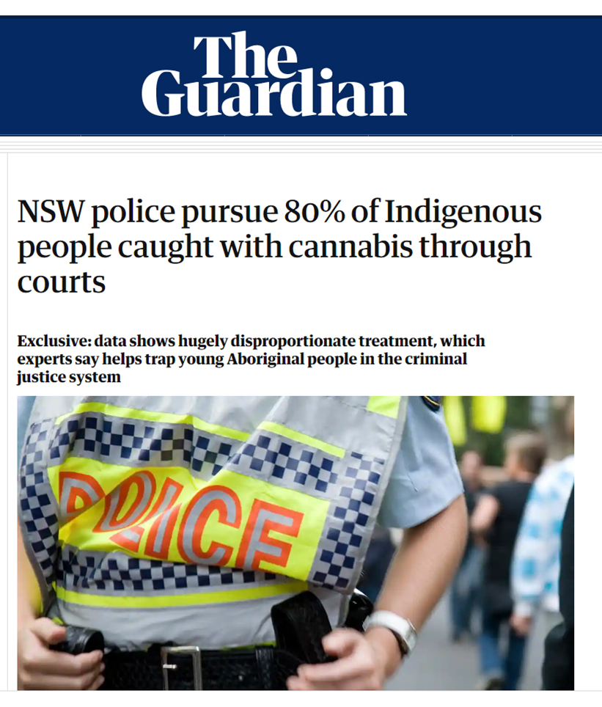
Literature on cannabis cautioning
Studies find drug diversion associated with:
Reductions in further offending¹
Employment benefits²
“Cautioning is like getting hit on the head with a wet lettuce, users will not change because of a caution.”³
Payne et al. (2008)
Shanahan et al. (2017)
Audit Office of NSW (2011)
Notes:
A 2020 media article used BOCSAR data from 2013-2017 and highlighted how Aboriginal offenders are cautioned much less than non-Aboriginal offenders.
This is concerning because past research suggests that cannabis cautioning is possibly associated with reductions in reoffending and improved employment outcomes.
Past research also shows that some police may view it as a soft option and discriminate against those who they think are more at risk for further offending. For example, from one report examining the scheme: ** Reveal quote** , a police officer alludes to it being about as effective a sanction as a wet cabbage, so it’s plausible that the gap may be caused by differences in who police deem worthy or unworthy of a caution.
The analysis in the Guardian article suggests that discrimination is a key driver of this gap. However, because they don’t offer any further analysis than raw statistics, this claim is untested.

Slide 5
Our study aims to disentangle the possible reasons for the disparity in cannabis cautioning
Differences in eligibility
Are Aboriginal people less likely to be eligible for cannabis cautions?
Differences in cohort affecting likelihood of caution
Are eligible Aboriginal offenders more likely to have risk factors reducing their likelihood of receiving a caution?
Differences in police areas in cautioning
Are Aboriginal offenders more likely to be caught with cannabis in police areas that are less likely to issue cannabis cautions?
Discrimination or bias
Are Aboriginal offenders less likely to be cautioned than similar non-Aboriginal offenders?
Notes:
This brings us to the topic of our study.
We wanted to examine this gap in cannabis cautioning between Aboriginal and non-Aboriginal adults caught in possession of cannabis.
To do this, we thought about some of the plausible reasons why this gap could exist. The four reasons we identified were (reveal)
Aboriginal people could be less likely to meet the eligibility criteria for the Scheme
There could be differences in characteristics which correlate to the likelihood of receiving a caution which differ between Aboriginal and non-Aboriginal people
Third, that some police areas are more or less likely to issue cannabis cautions in areas where more Aboriginal people reside.
Last, that Aboriginal adults caught with cannabis are indeed being treated more harshly.

Slide 6
We analyse 38,813 events of cannabis use/possession between 2017-2020
We have information on:
Demographics (age, gender, Aboriginality)
Any other offences on the same event
Criminal history (number and types of prior contacts)
Police Area Command
All 38,813 use/possess cannabis events from 2017-2020 where Aboriginality was recorded
Involving Aboriginal adults
8,171
Involving non-Aboriginal adults
30,642 (%)
Notes:
So what data do we use? We use all (approximately 38,000 use/possess cannabis events) from the COPS database where the Aboriginality of a person was recorded.
This is comparison with 30,642 (79%) observations on non-Aboriginal offenders and 8,171 (21%) observations on Aboriginal offenders
NEXT
Our dataset includes information on their demographics, other offences in the same event, criminal history, and the Police area where they were dealt with

Slide 7
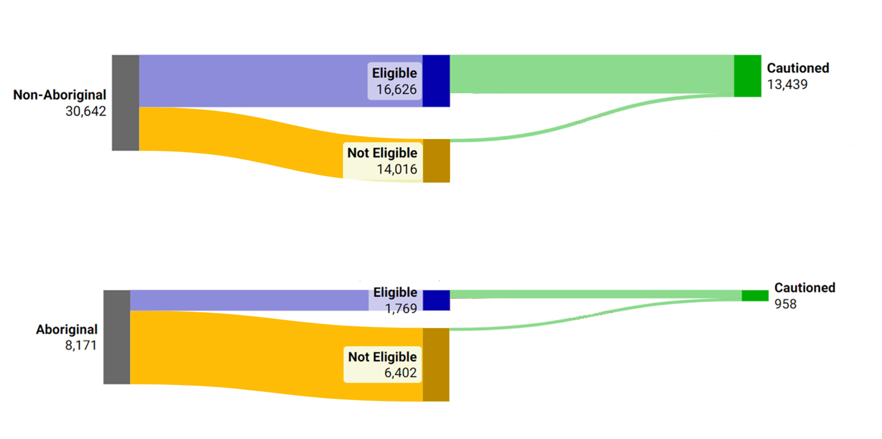

Aboriginal adults cautioned less than non-Aboriginal adults
44%
12%
12%
Notes:
In our sample, like that used in the Guardian article we also find a considerable gap in cannabis cautioning between Aboriginal and non-Aboriginal people.
We find that 44% of non-Aboriginal people caught in possession of cannabis receive a caution versus only 12 percent of non-Aboriginal people. This translates to a 32 percentage point raw disparity in cautioning rates.
If you’re wondering why I chose such a funny visualisation for this slide, all will become clear … shortly.

Slide 8
We first examine whether differences in eligibility explain differences in cautioning rates
Differences in eligibility
Are Aboriginal people less likely to be eligible for cannabis cautions?
Differences in cohort affecting likelihood of caution
Are eligible Aboriginal offenders more likely to have risk factors reducing their likelihood of receiving a caution?
Differences in police areas in cautioning
Are Aboriginal offenders more likely to be caught with cannabis in police areas that are less likely to issue cannabis cautions?
Unexplained bias
Are Aboriginal offenders less likely to be cautioned than similar non-Aboriginal offenders?
Notes:
Recall our four candidate explanations. First, let’s consider the first possibility: that differences in eligibility explain the gap in cautioning.

Slide 9






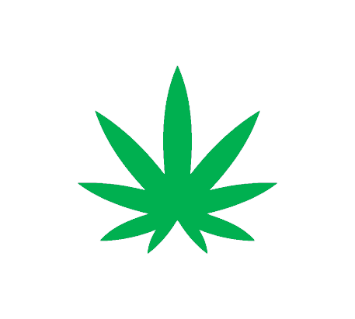

There are seven eligibility criteria for cannabis cautioning in NSW
Offender is an adult
Offender’s identity can be confirmed
No prior drug, violent or sexual offences
Offender consents to caution
No concurrent offences
Less than 2 prior cannabis cautions
Less than 15g of cannabis
Notes:
There are actually 7 eligibility criteria for cautioning in NSW
- The offender needs to be an adult who has no prior drug, violent or sexual offences and have not committed any other concurrent offences. They also must have fewer than 2 prior cannabis cautions.
NEXT

Slide 10
.. but we can only observe some in our data
Offender is an adult
Offender’s identity can be confirmed
No prior drug, violent or sexual offences
Offender consents to caution
No concurrent offences
Less than 2 prior cannabis cautions
Less than 15g of cannabis
Police can exercise their discretion not to caution eligible offenders
Notes:
Unfortunately we don’t have data on three potentially important eligibility criteria:
Less than 15g of cannabis
Whether the offender consents to a caution
Whether the offender’s identity can be confirmed
Thus, our concept of eligibility is limited to the four eligibility criteria we can see.
NEXT
Furthermore police can also exercise their discretion not to caution eligible offenders.

Slide 11
Aboriginal adults are less likely to be eligible than non-Aboriginal adults
54%
Differences in eligibility
22%
22%
Notes:
So, how much does eligibility, at least in terms of what we can see, explain the gap in cannabis cautioning?
We find that Aboriginal adults who are caught in possession of cannabis are indeed much less likely to be eligible for a caution.
Out of the 8,171 events involving Aboriginal people in our sample, in over 6,000 events, the offender was not eligible for a caution.
This translates to nearly 8 in 10 Aboriginal adults caught in possession of cannabis being excluded from the scheme on the basis of the eligibility criteria we observe alone.

Slide 12
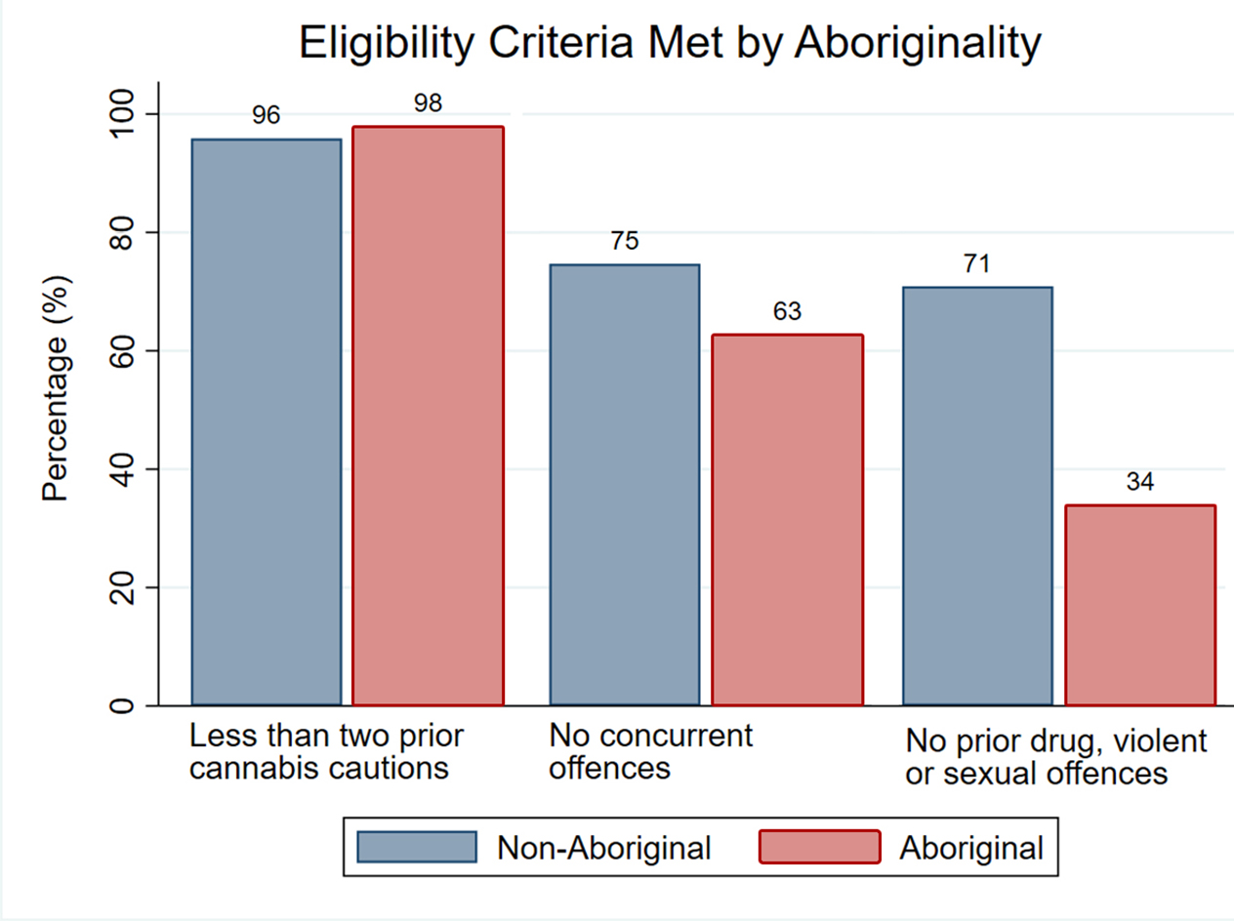
Aboriginal people have more prior drug, violent and sexual offending
Differences in Eligibility
Notes:
So which eligibility criteria are Aboriginal people less likely to meet?
In this chart we examine each of the three conditions (other than being an adult) and how much they contribute towards the exclusion of Aboriginal individuals from the scheme.
First, you can see that the limit on prior cannabis cautions isn’t driving much of the difference: for both non-Aboriginal and Aboriginal individuals less than 5% of offenders are excluded from this alone.

Slide 13
Aboriginal people have more prior drug, violent and sexual offending
Differences in Eligibility
Notes:
Aboriginal people are more likely to have a concurrent offence on the event. Specifically, only 63% of Aboriginal offenders in our sample met this criteria vs. 75% of non-Aboriginal people.

Slide 14
Aboriginal people have more prior drug, violent and sexual offending
Differences in Eligibility
Notes:
And finally, the majority of non-Aboriginal offenders have no prior drug, violent or sexual offences. However, only 34% of Aboriginal offenders have no prior drug, violent or sexual offences.
This eligibility criteria alone excludes over half of Aboriginal people from being eligible to receive a caution

Slide 15
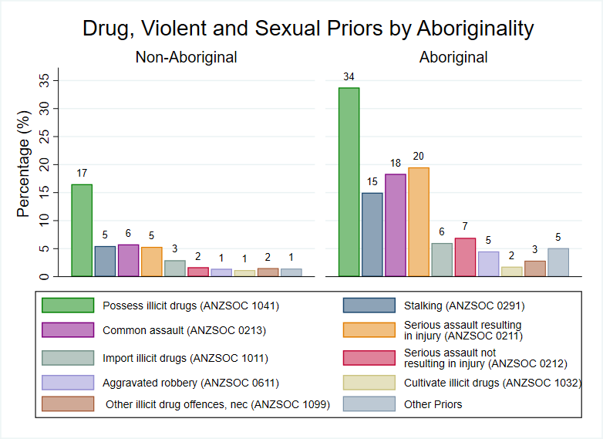
Aboriginal people more likely to have a prior illicit drugs offence
Differences in Eligibility
Notes:
This then, begs the question about what types of prior offences are contributing towards Aboriginal people being less likely to meet the eligibility criteria for the Scheme.
NEXT
Four offence types appear to be most responsible for more Aboriginal people being ineligible on the basis of prior offending.
Alarmingly, there are approximately twice the proportion of Aboriginal individuals in our sample with a prior use/possess drugs versus non-Aboriginal people. We haven’t looked at it in great detail in this study but there could be a possibility that some people are excluded from cannabis cautioning because they have been previously proceeded against for a cannabis offence,
Also of concern is that the Aboriginal individuals in our sample are also more likely to have assault and stalking offences.
The biggest gap in these individual offences comes because nearly one in four Aboriginal individuals in our sample have a serious assault resulting in injury charge versus only 5 per cent of the non-Aboriginal sample.
Prior BOCSAR research suggests that Aboriginal people may be over-policed for stalking offences, where we also observe a disparity here.

Slide 16
Aboriginal adults less likely to be eligible than non-Aboriginal adults
54%
Differences in Eligibility
22%
22%
Notes:
So, now we’ve established not only that the majority of Aboriginal people caught in possession of cannabis are ineligible for the Scheme, but that this because of prior offending. The next question is whether a gap remains when only considering those who are eligible.

Slide 17
Aboriginal adults cautioned less than non-Aboriginal adults
74%
Differences in Eligibility
40%
12%
Notes:
The short answer is yes. The chart shows the flow of eligible offenders into being cautioned. The blue percentages are the percent of eligible offenders who are cautioned in each group. Even among eligible offenders, we still find a 34 percentage point disparity in the likelihood of a cannabis caution. Nearly three-quarters of eligible non-Aboriginal offenders are cautioned, but only 40% eligible Aboriginal offenders are cautioned.

Slide 18
Aboriginal adults cautioned less than non-Aboriginal adults
44%
Differences in Eligibility
12%
12%
Notes:
Therefore, police applying discretion over who to caution among those eligible is also contributing towards the disparity in cautioning rates between the groups. (The percentages in the green bubbles are the original raw cautioning rates).
The next part of my presentation will try and identify factors which explain these differences in police decisions to caution.

Slide 19
How much of the difference is associated with differences in cohorts, police areas, and unexplained bias?
Differences in eligibility
Are Aboriginal people less likely to be eligible for cannabis cautions?
Differences in cohort affecting likelihood of caution
Are eligible Aboriginal offenders more likely to have risk factors reducing their likelihood of receiving a caution?
Differences in police areas in cautioning
Are Aboriginal offenders more likely to be caught with cannabis in police areas that are less likely to issue cannabis cautions?
Unexplained bias
Are Aboriginal offenders less likely to be cautioned than similar non-Aboriginal offenders?
Notes:
Lets look at our other three candidate explanations. That the cohorts differ in some characteristics which make police more or less likely to caution, that net of these factors, the groups are dealt with by police areas who may be more or less severe in their cautioning, or residual bias even after considering offenders with similar characteristics and in similar places.

Slide 20










Eligible Aboriginal offenders are different to eligible non-Aboriginal offenders
Demographics
Criminal history
Female +12p.p
Prior court +43 p.p
Female +12p.p
Age 35-54 +10p.p
Prior prison + 16 p.p
Age 35-54 +10p.p
Regional areas + 34 p.p
Prior public order offence + 15 p.p
Regional areas + 34 p.p
Lowest two SEIFA
quartiles +25p.p
Prior theft offence + 19 p.p
Lowest two SEIFA quartiles +25p.p
Prior property damage offence + 11 p.p
Notes:
I won’t put up a huge table of summary statistics but I’ll try to identify key differences between the groups.
Of the Aboriginal offenders in our sample, a greater proportion are female, aged 35-54 years old, and are much more likely to reside in regional areas and in more socioeconomically disadvantaged areas than the non-Aboriginal. This would factor into the gap if police were also more likely to exercise discretion in relation to these factors, for example, if they prefer to caution female offenders in general, for example.
CLICK
But the differences in the criminal history of our groups is particularly stark. The proportion of individuals in our Aboriginal cohort with prior court appearances was 43 percentage points higher than the non-Aboriginal group. A greater proportion had also previously received a prison penalty. And Aboriginal offenders were more likely to have a different types of prior offences unrelated to eligibility, as well.

Slide 21
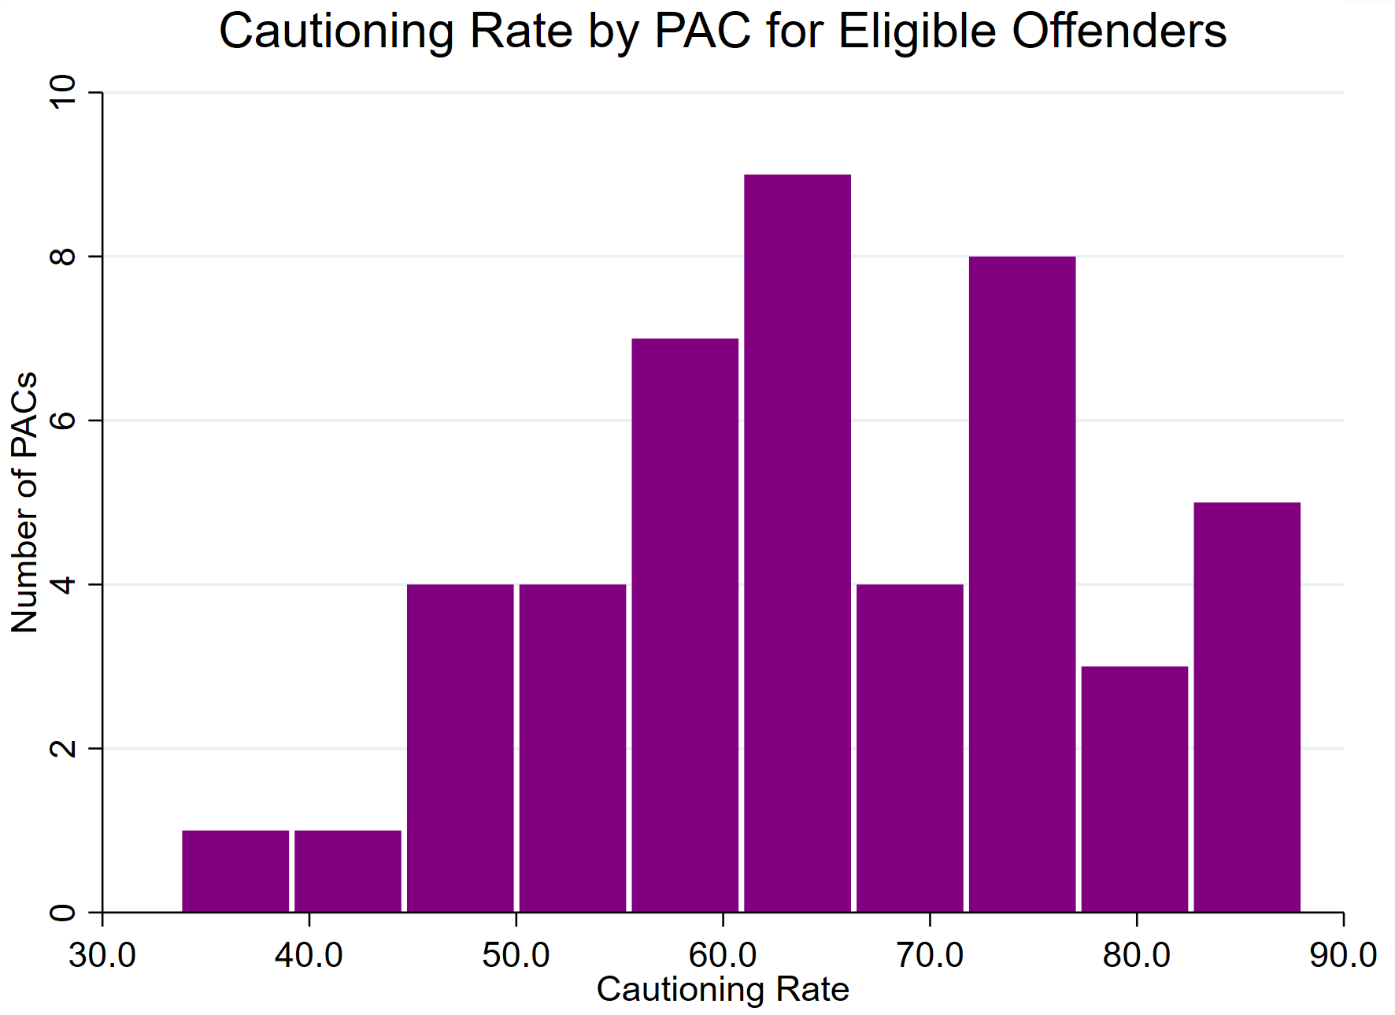
Police areas vary in use of cautioning, including for Aboriginal vs. non-Aboriginal people
Notes:
There is also police area variation in cautioning rates for eligible offenders. Most PACs caution around 60% of eligible offenders who are caught with cannabis. Some PACs are more lenient, cautioning around 85% of eligible offenders, while others are more strict, cautioning around 35% of eligible offenders.
These simple rates however, don’t consider differences in the characteristics of offenders being dealt with by each police area.
Therefore, to disentangle the contribution of offender characteristics and police area variation from other unobserved differences we need a method that’s able to consider and adjust for all these factors.

Slide 22


Method: Kitagawa-Oaxaca-Blinder decomposition
Break down the ~34p.p difference in cautioning rates for eligible offenders into:
  Explained C component
  Cautioning differences due to differences in observed characteristics:
  Prior offending
  Prior jail time
  PAC
  Demographics
  A U Unexplained
  C component
  Cautioning differences for offenders with same characteristics:
  Discrimination
  Unobserved offender characteristics
Notes:
We do this using a method called a Kitagawa-Oaxaca-Blinder decomposition, which has been used in many other contexts, most commonly to identify reasons for gaps in earnings between men and women.
How it works is by estimating a model using all the variables we have to predict cannabis cautioning, once for Aboriginal offenders and one for non-Aboriginal offenders. I won’t go through the proof (although I love its elegance) but rearranging terms from these models we can split the variation into two sources.
The first considers what the cautioning rate would be if the Aboriginal and non-Aboriginal offenders had the same characteristics, on average. In other words, how much of the gap in cautioning is explained by cohort differences? This is what we call the explained component.
The second considers what the cautioning rate for Aboriginal offenders would be if we treated them like non-Aboriginal offenders (at least as approximated by the non-Aboriginal model). Ideally this would represent purely differences in treatment. But in our setting, because we can’t account for some of variables influencing cautioning, it also captures unobserved variation from relevant omitted variable.
You might be wondering what is the advantage of departing from a single regression model as is typical in this type of work. The real advantage is that it can further decompose the gap down to individual variables, which I’ll go through next.

Slide 23
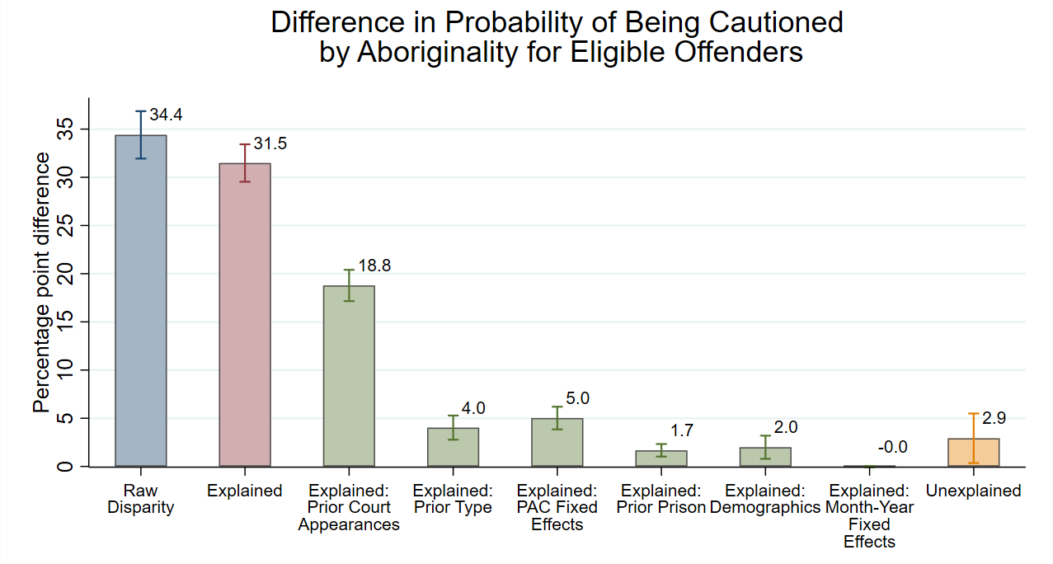
There is a 34.4 percentage point disparity in cautioning rates among eligible offenders
Cautioning – eligible offenders
Notes:
As I just mentioned, this technique allows us to take that 34.4 percentage point gap and break it down by its components. Lets start with what’s ‘explained’ in our model, which is just the variation that’s explained because of differences in the cohort.

Slide 24
92% of the disparity can be explained by variables in our data
Cautioning – eligible offenders
Notes:
The variables available to us explain 31.5 percentage points or 92% of that 34.4 percentage point gap in cautioning among eligible offenders.

Slide 25
Prior court appearances account for 59% of the disparity
Cautioning – eligible offenders
Notes:
Slightly more than half of explained component is driven by more eligible offenders’ in the Aboriginal group having prior court appearances. Specific types of prior offences, which we’ve grouped here for simplicity, explain a further 4 percentage points.
Notably, PAC severity (outside of these factors) is still driving 5 percentage points, or 14% of the gap among eligible offenders. Prior imprisonment and demographics explains the rest, and time explains barely any of the gap.

Slide 26
8% of the gap in cannabis cautioning remains unexplained
Cautioning – eligible offenders
Notes:
Taken together, this means that 2.9 percentage points or 8% of the gap in cannabis cautioning among eligible offenders remains unexplained.
This could be a signal of discrimination but could also be a product of the unobserved variables.

Slide 27




In summary…
Differences in eligibility
  Aboriginal people less likely to be eligible
  More prior drug & violent offences
  Police discretion
  Police less likely to caution those with prior offending and jail time
    2.9 p.p. (8%) remains unexplained (discrimination and/or unobservables)
  Limitations
  Our study is associative and there are missing variables
  High levels of prior offending may be driven by discrimination and over policing of Aboriginal communities¹
  Does not consider discrimination at other points in the criminal justice system
  Prior research has found racial bias in other contexts such as policing of youth offenders²
Blagg et al, (2005); Sentas & Pandolfini, (2017).
Allard et al. (2009); Papalia et al., (2019); Snowball, (2008); Weatherburn & Thomas, (2022).
Notes:
So what can we conclude?
We find that there are two major drivers of the gap in cannabis cautioning. First, eligibility, where nearly 8 in 10 Aboriginal individuals are excluded from the scheme, mostly due to having prior drug and violent offences.
Second, that police are applying discretion not to caution some offenders, particularly those with prior criminal histories.
However, a small gap (2.9%) still remains which cannot be explained by the factors available to us.
CLICK
Unfortunately , our study isn’t perfect. There are some important caveats which should be noted here.
First and most importantly our results are associative and not causal, and we have important omitted variables
Most important is that some of our variables could be in themselves, biased, if they are driven by overpolicing in Aboriginal communities for particular offences, such as stalking.
Our method is unable to adjust or account for any bias in other parts of the criminal justice system.
Studies of juvenile diversion of Aboriginal and non-Aboriginal young people find persistent gaps in outcomes even after controlling for the characteristics of young people.

Slide 28

How can we close the gap?
Relax eligibility criteria
Reduce scope for police discretion
Address factors which contribute to Aboriginal involvement in the criminal justice system
Conclusions
Notes:
So what do our results mean for ways of closing the gap in cannabis cautioning outcomes?
One option that policymakers may want to consider is relaxing the eligibility criteria. On first glance, our results would suggest that much of the gap can be eliminating by simply removing some of the criteria. But it’s worth remembering that police can still exercise discretion in how they caution, so in effect only some of these newly eligible individuals could go on to be cautioned.
NEXT
The next option is restricting or removing police discretion entirely, enabling all eligible offenders to be cautioned. Comparable diversion programs in QLD and SA already do this, so there is precedent for this. Perhaps even some degree of both options could be especially effective.
NEXT
Ultimately however, our research reinforces the need to address the factors leading to overrepresentation and the accumulation of prior offending among Aboriginal people in the criminal justice system, whether this involves actions that target the root causes of offending, early intervention, or remedying diversion at other points in the criminal justice system, such as youth diversion.
Thank you again for your time, I’ll wrap up here. Looking forward to your questions.

Slide 29
THANK YOU
Notes:
Thank you again for your time,

Slide 30
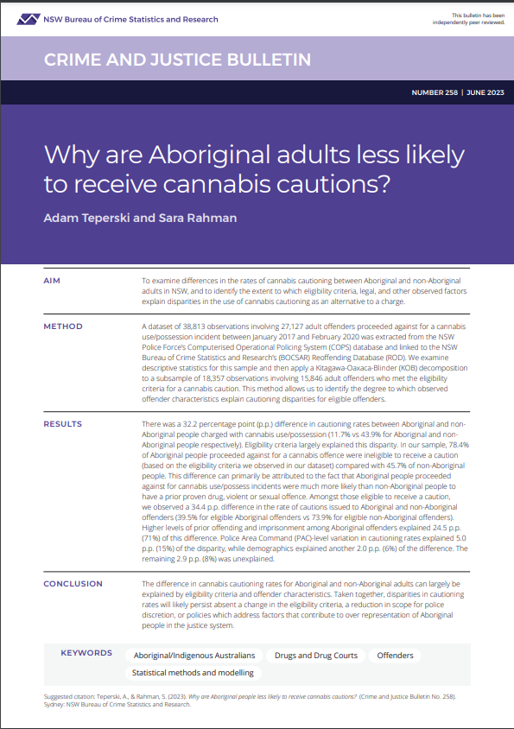
GET IN TOUCH
CONTACT US
6 Parramatta Square
Level 5, 10 Darcy St, Sydney NSW 2000
(02) 8346 1100
bcsr@justice.nsw.gov.au
https://www.bocsar.nsw.gov.au/
@BOCSAR
NSWBOCSAR
Notes:
If you’re interested in our paper, it’s published on the BOCSAR website, and you can contact us after the conference if anything comes to mind.

Slide 31
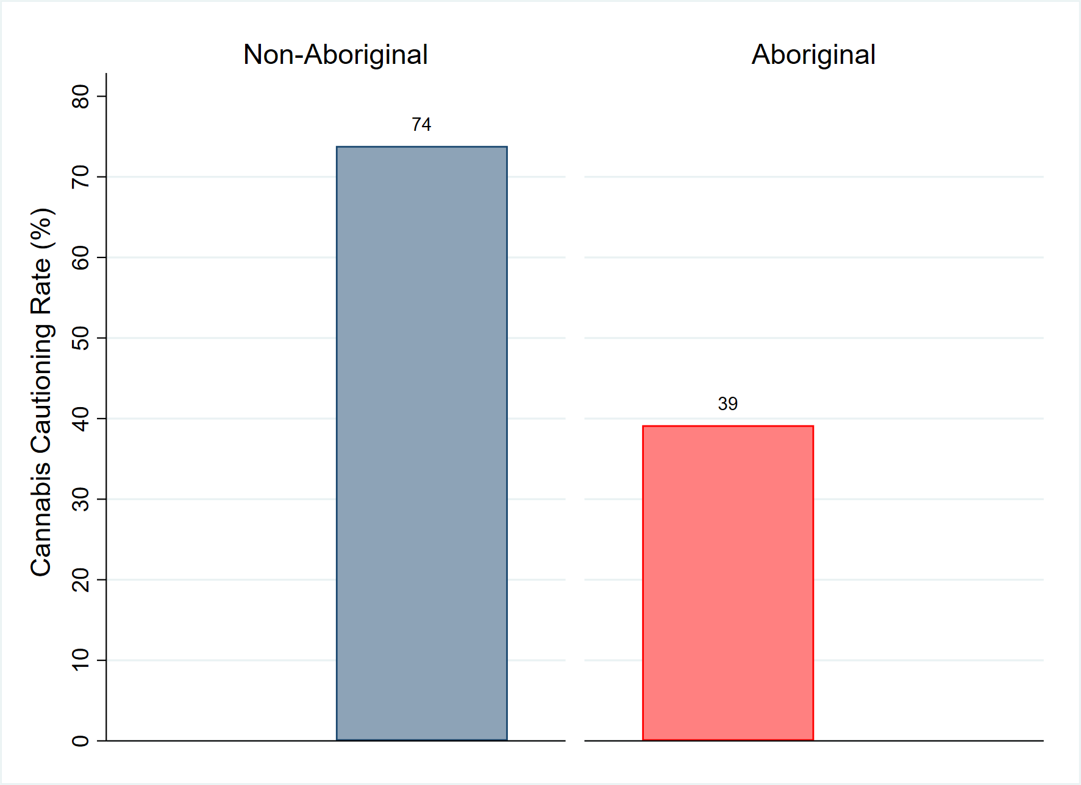
Cautioning disparity persists for eligible offenders
CAUTIONING – ELIGIBLE OFFENDERS
Difference = 34p.p.

Slide 32
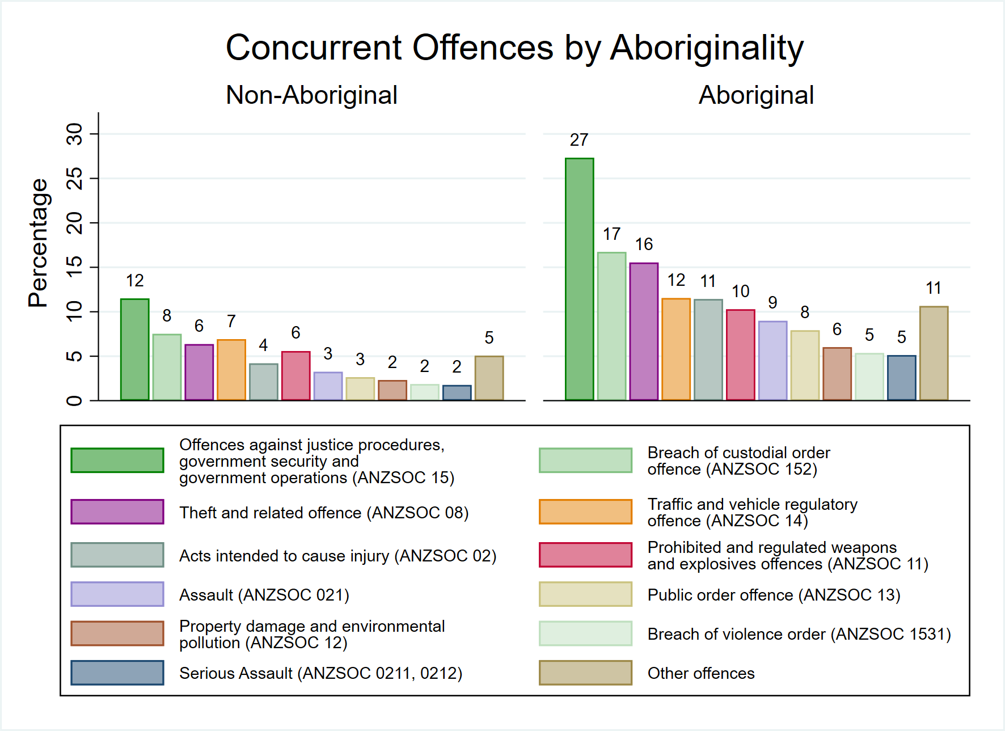
Notes:
Main differences in concurrent offences are offences against justice procedures, breaches of custodial orders, & theft

