Slide 1

Trends in rates of victimisation and
offending for people with disability in NSW
National Disability Data Asset Pilot
NSW Justice Test Case

Slide 2
BACKGROUND
METHOD
QUESTION 1
QUESTION 2
What are the
adjusted offending
rates of people
with disability?
What are
the adjusted
victimisation
rates of people
with disability?
What is the
National Disability
Data Asset Pilot?
How did we
identify people
with disability?

Slide 3
BACKGROUND
METHOD
QUESTION 1
QUESTION 2
What are the
adjusted offending
rates of people
with disability?
What are
the adjusted
victimisation
rates of people
with disability?
What is the
National Disability
Data Asset Pilot?
How did we
identify people
with disability?

Slide 4


The National Disability Data Asset (NDDA) is proposed to be a large linked dataset bringing together multiple sources of information about People with Disability and their service usage
In doing so, an enduring NDDA would aim to:
Provide a more complete picture of the life experiences of people with disability
See, hear and understand people with disability as a diverse community with specific needs and goals
Develop a better understanding of how people with disability are supported through services, payments and programs across multiple service systems
4

Slide 5


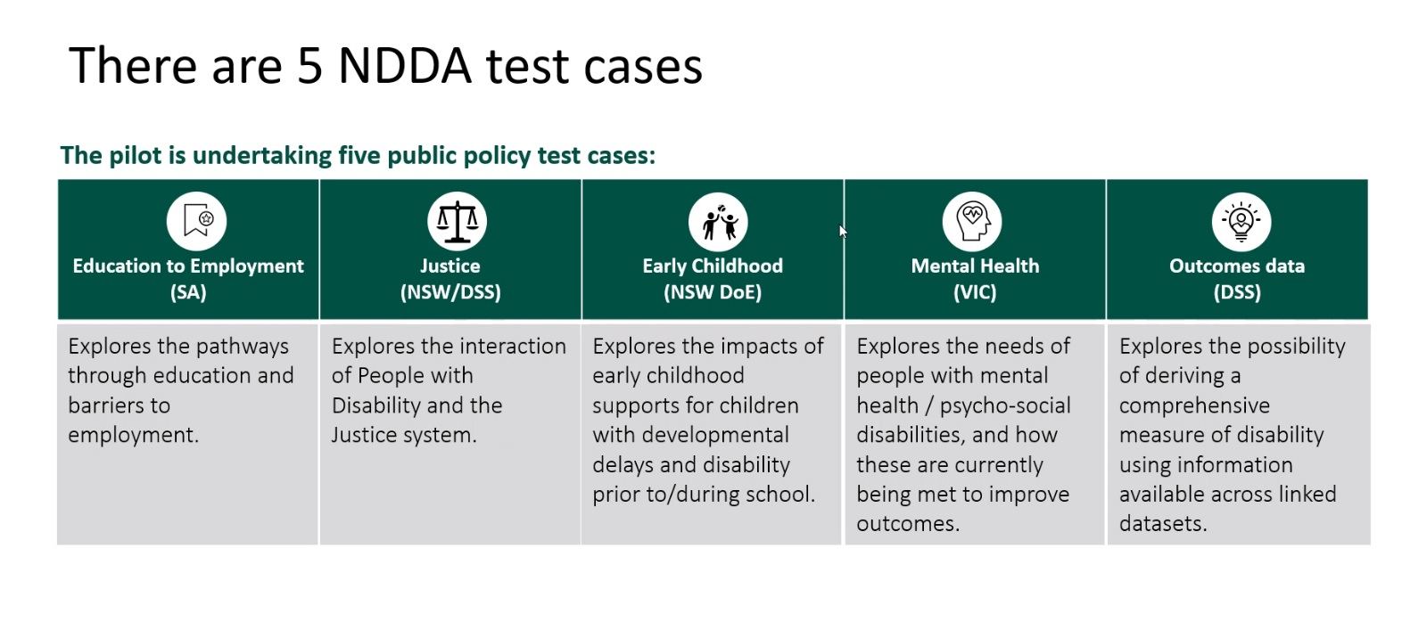
The Justice test case is one of five projects that were designed to demonstrate the benefits of developing the NDDA as an enduring linked data asset.
Justice (NSW/DSS) | Education to Employment (SA) | Early Childhood (NSW DoE) | Mental Health (VIC) | Outcomes Data (DSS)
Explores the interaction of People with Disability and the Criminal Justice System. | Explores the pathways through education and barriers to employment. | Explores the impacts of early childhood supports for children with developmental delays and disability prior to and during school. | Explores the needs of people with mental health and psychosocial disabilities, and how these are currently being met to improve outcomes. | Explores the possibility of deriving a comprehensive measure of disability using information available across linked datasets.

Slide 6
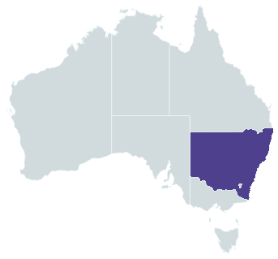
The Justice test case is one of five projects that were designed to demonstrate the benefits of developing the NDDA as an enduring linked data asset.
Justice (NSW/DSS) | Education to Employment (SA) | Early Childhood (NSW DoE) | Mental Health (VIC) | Outcomes Data (DSS)
Explores the interaction of People with Disability and the Criminal Justice System.
In-scope population for this test case
Residents of NSW at any time during 2009-2018
Aged 10 years or older
In contact with criminal justice system as victim or offender, OR recipients of core disability services or supports (i.e., NDIS, Disability Support Pension & state-based Specialist Disability Services)

Slide 7
The linked dataset covers 2.8 million individuals:
712,000 people
receiving disability
services or supports
2.3 million people
in contact with the justice system
(as victims and/or offenders)

Slide 8
The test case was supported by a variety of teams from state government, Commonwealth government, Australian universities, and community organisations
Project team
NSW Bureau of Crime Statistics and Research, Research team
Suzanne Poynton
Principal Investigator
Clare Ringland
Stewart Boiteux
Centre Forensic Behavioural Science, Swinburne University of Technology, Research team
Rachael Fulham
Anne Sophie Pichler
Caleb Lloyd
Margaret Nixon
Aboriginal Perspectives Expert Panel
Deborah Nanschild
Facilitator
Caroline Atkinson
We Al-Li
Damian Griffis
First Peoples Disability Network
Eileen Baldry
UNSW
Peta Macgillivray
Aboriginal Legal Service Board Yuwaya Ngarra-li Partnership
Mark Munnich
Aboriginal Legal Service
Implementation team
Celia Walker
NSW DCS
Ana Sartbayeva
DSS
Jo Maning
DSS
Seb Dunne
AIHW
Ximena Camacho
NPT
Advisory project team
Julian Trollor
UNSW
Philip Snoyman
NSW Corrective Services
This work is supported by the Commonwealth Government through the NDDA pilot project.

Slide 9


Reporting on the outcomes of Aboriginal people with disability was guided by an embedded Aboriginal perspectives expert advisory panel.
“At our first workshop we recognised
the issues of our mob not identifying.
But we did think it was important to be able
to identify our mob in the data.”
—Aboriginal perspectives expert advisory panel
“For good reasons many First-nations people won’t
disclose that they have a disability.
It might not be to your benefit to tell anybody
too much about yourself.
It might make you more vulnerable.”
—Aboriginal perspectives expert advisory panel

Slide 10
0
QUESTION 1
BACKGROUND
METHOD
QUESTION 2
What are the
adjusted offending
rates of people
with disability?
What are
the adjusted
victimisation
rates of people
with disability?
What is the
National Disability
Data Asset Pilot?
How did we
identify people
with disability?

Slide 11














The linked data collection for this test case was composed of 14 main datasets.
14. Pharmaceutical
Benefits
Scheme
1. National Disability
Insurance Scheme (NDIS)
2. Disability Services
National Minimum Data Set (DSNMDS)
13. Medicare
Benefits
Schedule
3. Department of Social Services
Data Over Multiple Individual Occurrences (DOMINO)
12. Specialist
Homelessness
Services Collection
4. NSW BOCSAR
Re-Offending Database
Data collections utilised in Justice test case
11. NSW FACS
social housing
5. NSW Police
Computerised Operational Policing
System (COPS)- victims extract
10. NSW FACS
child protection
and out-of-home care
6. Corrective Services NSW
custodial episodes
7. National Hospital
Morbidity Database
9. National
Death Index
8. National Non-admitted Patient
Emergency Department Care Database

Slide 12











Three main disability datasets were used to construct an initial cohort of People with Disability.
14. Pharmaceutical
Benefits
Scheme
1. National Disability
Insurance Scheme (NDIS)
2. Disability Services
National Minimum Data Set (DSNMDS)
13. Medicare
Benefits
Schedule
3. Department of Social Services
Data Over Multiple Individual Occurrences (DOMINO)
12. Specialist
Homelessness
Services Collection
4. NSW BOCSAR
Re-Offending Database
Data collections utilised in Justice test case
11. NSW FACS
social housing
5. NSW Police
Computerised Operational Policing
System (COPS)- victims extract
10. NSW FACS
child protection
and out-of-home care
6. Corrective Services NSW
custodial episodes
7. National Hospital
Morbidity Database
9. National
Death Index
8. National Non-admitted Patient
Emergency Department Care Database

Slide 13

Three criminal justice system datasets were used.
14. Pharmaceutical
Benefits
Scheme
1. National Disability
Insurance Scheme (NDIS)
2. Disability Services
National Minimum Data Set (DSNMDS)
13. Medicare
Benefits
Schedule
3. Department of Social Services
Data Over Multiple Individual Occurrences (DOMINO)
12. Specialist
Homelessness
Services Collection
4. NSW BOCSAR
Re-Offending Database
Data collections utilised in Justice test case
11. NSW FACS
social housing
5. NSW Police
Computerised Operational Policing
System (COPS)- victims extract
10. NSW FACS
child protection
and out-of-home care
6. Corrective Services NSW
custodial episodes
7. National Hospital
Morbidity Database
9. National
Death Index
8. National Non-admitted Patient
Emergency Department Care Database

Slide 14
Eight other mainstream service datasets were used.
14. Pharmaceutical
Benefits
Scheme
1. National Disability
Insurance Scheme (NDIS)
2. Disability Services
National Minimum Data Set (DSNMDS)
13. Medicare
Benefits
Schedule
3. Department of Social Services
Data Over Multiple Individual Occurrences (DOMINO)
12. Specialist
Homelessness
Services Collection
4. NSW BOCSAR
Re-Offending Database
Data collections utilised in Justice test case
11. NSW FACS
social housing
5. NSW Police
Computerised Operational Policing
System (COPS)- victims extract
10. NSW FACS
child protection
and out-of-home care
6. Corrective Services NSW
custodial episodes
7. National Hospital
Morbidity Database
9. National
Death Index
8. National Non-admitted Patient
Emergency Department Care Database

Slide 15
The initial disability cohort likely underestimates the true number of people with disability.
14. Pharmaceutical
Benefits
Scheme
1. National Disability
Insurance Scheme (NDIS)
2. Disability Services
National Minimum Data Set (DSNMDS)
13. Medicare
Benefits
Schedule
3. Department of Social Services
Data Over Multiple Individual Occurrences (DOMINO)
12. Specialist
Homelessness
Services Collection
4. NSW BOCSAR
Re-Offending Database
Data collections utilised in Justice test case
11. NSW FACS
social housing
5. NSW Police
Computerised Operational Policing
System (COPS)- victims extract
10. NSW FACS
child protection
and out-of-home care
6. Corrective Services NSW
custodial episodes
7. National Hospital
Morbidity Database
9. National
Death Index
8. National Non-admitted Patient
Emergency Department Care Database

Slide 16
To account for this, the cohort has been supplemented with additional information from other mainstream service datasets.
14. Pharmaceutical
Benefits
Scheme
1. National Disability
Insurance Scheme (NDIS)
2. Disability Services
National Minimum Data Set (DSNMDS)
13. Medicare
Benefits
Schedule
3. Department of Social Services
Data Over Multiple Individual Occurrences (DOMINO)
12. Specialist
Homelessness
Services Collection
4. NSW BOCSAR
Re-Offending Database
Data collections utilised in Justice test case
11. NSW FACS
social housing
5. NSW Police
Computerised Operational Policing
System (COPS)- victims extract
10. NSW FACS
child protection
and out-of-home care
6. Corrective Services NSW
custodial episodes
7. National Hospital
Morbidity Database
9. National
Death Index
8. National Non-admitted Patient
Emergency Department Care Database

Slide 17
Examples of conditions and disorders by disability type.
​ | DISABILITY TYPE​
CONDITION, DISORDER or DISEASE​ | COGNITIVE​ | PHYSICAL​ | PSYCHOSOCIAL​
Intellectual Disability (mild to profound)​ | ⬤​ | ​ | ​
Traumatic brain injury​ | ⬤​ | ​ | ​
Autism​ | ⬤​ | ​ | ​
Fetal alcohol syndrome​ | ⬤​ | ⬤​ | ​
Down syndrome​ | ⬤​ | ⬤​ | ​
Cerebral palsy​ | ​ | ⬤​ | ​
Visual impairment (including blindness)​ | ​ | ⬤​ | ​
Hearing loss​ | ​ | ⬤​ | ​
Alcohol or other substance dependency​ | ​ | ​ | ⬤​
Schizophrenia​ | ​ | ​ | ⬤​
Bipolar affective disorder​ | ​ | ​ | ⬤​
Major depressive illness​ | ​ | ​ | ⬤​
Borderline personality disorder​ | ​ | ​ | ⬤​
​ | ​ | ​ | ​

Slide 18
The linked dataset covers 2.8 million individuals:
230,000 people
receiving disability services/supports
AND in contact with the justice system
132,000 people
with disability only identified in mainstream service systems, who were contact with the justice system
712,000 people
receiving disability
services or supports
2.3 million people
in contact with the justice system
(as victims and/or offenders)

Slide 19
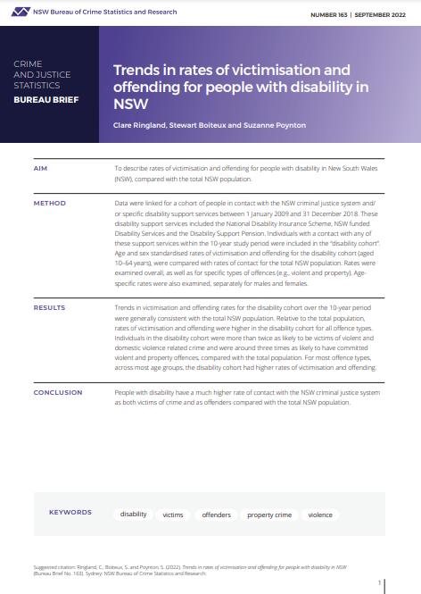
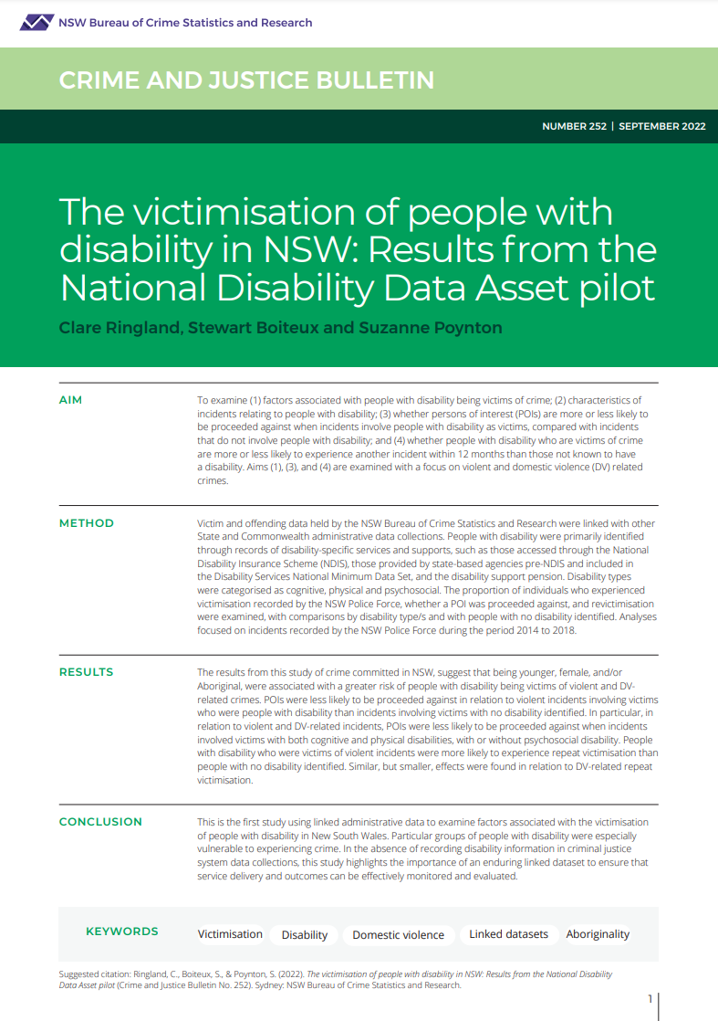
The test case has produced four BOCSAR reports, with two already published

Slide 20
The test case has produced four BOCSAR reports, with two already published

Slide 21
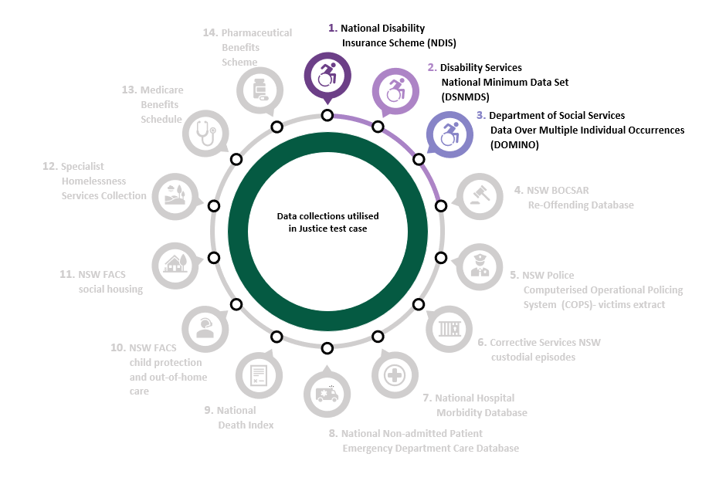
People with disability were identified through their contact with the three main disability services

Slide 22
Offending and victimisation rates were age and sex standardised to avoid confounding by age and sex, and to improve comparability between years

Slide 23
BACKGROUND
METHOD
QUESTION 1
QUESTION 2
What are the
adjusted offending
rates of people
with disability?
What are
the adjusted
victimisation
rates of people
with disability?
What is the
National Disability
Data Asset Pilot?
How did we
identify people
with disability?

Slide 24
Age and sex standardised rates of offending: Any offence
TREND: ▼ Decreasing trend
18% reduction from 2009 to 2018
TREND DIFFERENCE: ━ Stable difference
No statistically significant divergence between people with disability and the
total population between 2009 and 2018
AVERAGE DIFFERENCE: ▲ Higher rate
2.5x higher rate experienced by people with disability

Slide 25
Age and sex standardised rates of offending: Property offending
TREND: ▼ Decreasing trend
23% reduction from 2009 to 2018
TREND DIFFERENCE: ━ Stable difference
No statistically significant divergence between people with disability and the
total population between 2009 and 2018
AVERAGE DIFFERENCE: ▲ Higher rate
3.3x higher rate experienced by people with disability

Slide 26
Age and sex standardised rates of offending: Violent offending
TREND: ━ Stable trend
4% non-significant reduction from 2009 to 2018
TREND DIFFERENCE: ━ Stable difference
No statistically significant divergence between people with disability and the
total population between 2009 and 2018
AVERAGE DIFFERENCE: ▲ Higher rate
3.2x higher rate experienced by people with disability

Slide 27
Age and sex standardised rates of offending: Domestic violence related offending
TREND: ▲ Increasing trend
68% increase from 2009 to 2018
TREND DIFFERENCE: ━ Stable difference
Statistically insignificant divergence between people with disability and the
total population between 2009 and 2018
AVERAGE DIFFERENCE: ▲ Higher rate
3.2x higher rate experienced by people with disability

Slide 28
BACKGROUND
METHOD
QUESTION 1
QUESTION 2
What are the
adjusted offending
rates of people
with disability?
What are
the adjusted
victimisation
rates of people
with disability?
What is the
National Disability
Data Asset Pilot?
How did we
identify people
with disability?

Slide 29
Age and sex standardised rates of criminal victimisation: Any incident
TREND: ▼ Decreasing trend
18% decrease from 2009 to 2018
TREND DIFFERENCE: ━ Stable difference
No statistically significant divergence between people with disability and the
total population between 2009 and 2018
AVERAGE DIFFERENCE: ▲ Higher rate
1.6x higher rate experienced by people with disability

Slide 30
Age and sex standardised rates of criminal victimisation: property incidents
TREND: ▼ Decreasing trend
18% decrease from 2009 to 2018
TREND DIFFERENCE: ▲ Increasing difference
Statistically significant divergence
between people with disability and the
total population between 2009 and 2018
AVERAGE DIFFERENCE: ▲ Higher rate
1.2x higher rate experienced by people with disability

Slide 31
Age and sex standardised rates of criminal victimisation: violent incidents
TREND: ▼ Decreasing trend
17% decrease from 2009 to 2018
TREND DIFFERENCE: ━ Stable difference
No statistically significant divergence between people with disability and the
total population between 2009 and 2018
AVERAGE DIFFERENCE: ▲ Higher rate
2.6x higher rate experienced by people with disability

Slide 32
Age and sex standardised rates of criminal victimisation: domestic violence related incidents
TREND: ▼ ━ Stable trend
1% non-significant reduction from 2009 to 2018
TREND DIFFERENCE: ━ Stable difference
No statistically significant divergence between people with disability and the
total population between 2009 and 2018
AVERAGE DIFFERENCE: ▲ Higher rate
2.7x higher rate experienced by people with disability

Slide 33
BACKGROUND
METHOD
QUESTION 1
QUESTION 2
What are the
adjusted offending
rates of people
with disability?
What are
the adjusted
victimisation
rates of people
with disability?
What is the
National Disability
Data Asset Pilot?
How did we
identify people
with disability?

Slide 34
Summary of key offending and victimisation rate metrics
​ | QUESTION 1 What are the adjusted offending rates of people with disability? |  |  | QUESTION 2 What are the adjusted victimisation rates of people with disability?
​Incident or offence type | Rate per 100,000 people with disability​ | Trend from 2009 to 2018​ | Difference compared to total population​ | Rate per 100,000 people with disability​ | Trend from 2009 to 2018​ | Difference compared to total population​
Any​ | 5,003​ | ▼Decrease -13%​ | ▲ 2.5x​ | 7,012​ | ▼Decrease -18%​ | ▲ 1.6x​
Property​ | 927​ | ▼Decrease -23%​ | ▲ 3.3x​ | 2,706​ | ▼Decrease -18%​ | ▲ 1.2x​
Violent​ | 1,467​ | ━ Stable -4%​ | ▲ 3.2x​ | 3,077​ | ▼Decrease -17%​ | ▲ 2.6x​
Domestic violence​ | 930​ | ▲Increase +68%​ | ▲ 3.2x​ | 1,846​ | ━ Stable -1%​ | ▲ 2.7x​

Slide 35
GET IN TOUCH
6 Parramatta Square
Level 5, 10 Darcy St, Sydney NSW 2000
(02) 8346 1100
bcsr@justice.nsw.gov.au
https://www.bocsar.nsw.gov.au/
@BOCSAR
NSWBOCSR

Slide 36
THANK YOU

