Slide 1
Signalling desistance?
The role of prison-based
vocational training programs
      Dr Robin Fitzgerald, UQ
      Dr Adrian Cherney, UQ
      Dr Maria Plotnikova, UQ

Slide 2

Most offenders desist from crime, but they do so at varying and not easily predictable speeds.
(Kurlycheck, Bushway & Brame 2012)

Slide 3
Two contradictory facts
On average, offenders who take corrections-based employment programs have higher rates of employment and lower rates of recidivism. (e.g., Callan & Gardner, 2007)
Experimental research shows weak evidence of a causal link between employment programs and improved outcomes. (e.g., Visher, Winterfield & Coggeshall, 2005)
Therefore
  …voluntary enrolment itself might be the missing ingredient in the experimental studies.

Slide 4
Desistance theory
If it is unreasonable to expect employment programs to ‘produce’ desistance from offending, desistance theory provides a framework for understanding how ‘motivation’ might be the intervening factor.
Would-be ‘desisters’ construct narratives that lead to new non-criminal identities (Maruna 2001, Giordano et al. 2002)
We ask whether voluntary enrolment in VET programs could be an indicator of this changed identity.

Slide 5
Program participation as a ‘signal’
Bushway & Apel (2012)
Ask: how can outside observers better assess when offenders are desisting?
They dust off a labour economics theory (Spence 1973).
  In the absence of perfect information about potential employees, employers can reliably look to signals like education and skills training completion as indicators of the otherwise unobservable quality of commitment to work.
  Significant hurdle.
Propose that voluntary completion of post-prison employment programs could serve as signals for those interested in desistance.

Slide 6

A mixed-method approach
Quantitative study
Qualitative study

Slide 7
Quantitative study – Questions
Do offenders who take prison-based Vocational and Educational Training (VET) programs have lower chances of re-offending than those who do not?
Is full rather than partial completion required?
Is any positive result related to a generally high participation in all types of programs?

Slide 8
Quantitative study – Data
Queensland Corrective Services Integrated Offender Management System (IOMS)
About 5,500 short-sentenced prisoners
  sentences of 3 years or less, sentenced to court ordered parole.
  released on parole in 2007 or 2008.
Why short-sentenced offenders?
  Most (55%) enrol in VET programs
  Don’t need to impress a parole board
  Significant hurdle – easier not to enrol
  The need to test partial completion

Slide 9
Quantitative study – Groups
VET program completers
VET program partial completers
Non-enrollers

Slide 10
Quantitative study – ‘Survival Analysis’
Tracked offenders forward from the date of their index release until either the first reimprisonment or the end of 3-yr follow-up.
Model the hazard rate of recidivism.

Slide 11
Quantitative study – Analysis
Created matched groups of (1) VET completers & non-enrollers, (2) VET partial completers & non-enrollers and (3) VET completers & partial completers using Propensity score matching.
  Ensuring groups were equivalent on a full range of demographic, legal & institutional variables, and differed only in their VET participation.
Estimated ‘survival’ times across the 3 comparisons – using Kaplan-Meier estimation with log-rank test – to determine if there were statistically significant differences.
Tested whether any gains for the VET groups were due to the gains they received from other types of programs in a series of Cox regression models.

Slide 12
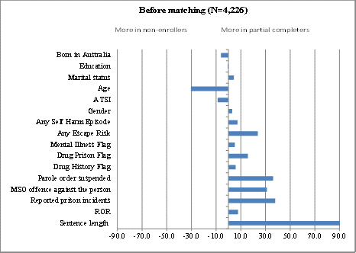
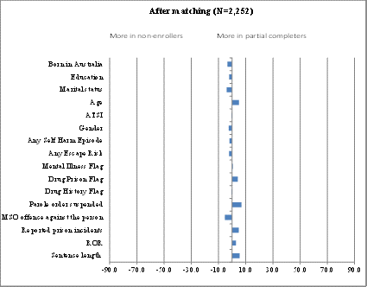
Quantitative study – Matching
Propensity score matching resulted in significant improvements in similarity between groups in each of our pairs.

Slide 13
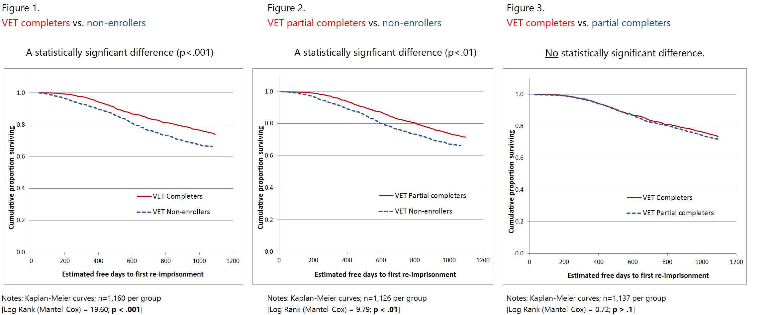
Quantitative study – survival

Slide 14
Quantitative study – Groups
VET program completers
VET program partial completers
Non-enrollers
Percentage in each group who were re-imprisoned by the end of the 3-year period.
26%
28%
35%

Slide 15
Quantitative study – Cox Models
What about the influence of other programs?
Cox regression model results show:
  Net of other types of offender programs.
    VET completers v. non-enrollers:
      Completers 42% lower chances of reimprisonment (p<.001)
    VET Partial completers v. non-enrollers:
      Partial completers 25% lower chances of reimprisonment (p <.01)
    VET competers v. partial completers.
      No statistical difference (p>.1)

Slide 16
Quantitative study – Implications
For short-term offenders, completing and/or participating in VET programs associated with lower chances of being re-imprisoned than non-enrolment.
… this holds over and above any effect of other offender programs.
The reason for the improved outcomes might be entirely due to skills gained from programs, but…
  experimental research shows no causal effect (Visher et al. 2005).
How might our results be explained in light of these earlier research findings?

Slide 17
Quantitative study – Implications
There are a number of possible explanations.
  Skills are only gained when participation is voluntary.
  Attainment of skills does not really matter in the ultimate decision to desist, rather it is the desire to desist or “make good” (Maruna 2001) itself that is the important factor.
  Or, a combination of these explanations.

Slide 18


Qualitative study of offenders’ views of work & training inside

Slide 19
Qualitative study – Questions, data
In-depth interviews with n = 50 parolees (Brisbane).
Today, will draw on results from n = 43 participants:
  16% women, 84% men; 14% Indigenous.
We were interested in participants’:
  descriptions of prison work and VET programs,
  motivations for engaging with these activities, and
  opinions about benefits they obtained from the activities.

Slide 20
Qualitative study – Findings
Most respondents were realistic about the limitations of these activities as a viable ‘ticket’ for employment on the outside:
    …they only give you bits and pieces of a course. You can't actually do a course all the way through. They're useful to get knowledge, but they're not useful for gaining employment. It's as simple as that.
    ‘Ryan’, age 38

Slide 21
The cynic
21%, n = 9 participants.
  I didn’t care about none of that stuff. The last thing I was going to do was work for them. I just went about my day, just until I got out.
  ‘Stuart’, age 37

Slide 22
The Utilitarian
44%, n = 19 participants.
  You can't even afford to buy some chips for the footy. So that’s why you work. And also, if you're doing a couple of years and you work it through, then it flies.
  ‘Scott’, age 30

Slide 23
The Optimist
35%, n = 15 participants.
  I done everything man. I was thinking, this will be part of my future. This is for when I get out. When I get out maybe I’m going to get a job. I’ll be a different man. I'll be changed.
  ‘Andrew’, age 48

Slide 24

In sum…
Quantitative results show improved outcomes for VET completers/participators.
Qualitative results show variation in the way offenders frame their participation in work & training.
Suggests
  for some, participation may be an early signal of identity change.
  Prison a ‘turning point’ (Soyer 2013) … but external success likely depends on a combination of motivation (voluntary participation) and skills or knowledge achievement.

