Slide 1
Life course offending patterns across gender and indigenous status in an Australian birth cohort
Lisa M. Broidy, Anna L. Stewart, Carleen M. Thompson, April Chrzanowski, Troy Allard and Susan M. Dennison
Griffith University, School of CCJ and Key Centre for Ethics, Law, Justice and Governance

Slide 2
Project Aims
To detail life course offending patterns in an Australian birth cohort
To explore variation in life course offending patterns by gender and by Indigenous status
To examine how gender and Indigenous status interact to influence life course offending patterns—Intersectionality

Slide 3
Background
Life course theory and research is data intensive
    Requires longitudinal data from childhood into adulthood
Five common offending patterns emerge from these data
    Non-offender
    Low-rate
    Chronic
    Adolescent limited
    Adult onset
Primarily based on male samples outside Australia
    Do patterns in Australian data mirror these?
    Do these patterns hold across gender and race/ethnicity?

Slide 4
Background
Few developmental life course studies using Australian data
    Marshall (2006): Juveniles in SA
        Gender and Indigenous status as covariates for group membership
    Livingston et al. (2008): Juveniles in QLD
        Gender and Indigenous status as covariates for group membership
    Fitzgerald et al. (2012): Juveniles in QLD
        Compare trajectories across gender
    Ferrante (2013): Adult Offenders in WA
        Trajectories disaggregated by gender AND by Indigenous status
Overall
    Similar offending groups in Australian data as in other cross-national studies
    Variation across gender and Indigenous status on group membership
Notes:
e.g.—child maltreatment

Slide 5
Background
Limited attention to gender and race/ethnicity in Life course studies
    Cross-sectional studies highlight the importance of both to our understanding of offending outcomes
    Females under-represented and racial/ethnic minorities over-represented among offenders
    Important to understand the life course patterns and processes that underlie these outcomes
Developmental/Life course studies beginning to address these issues
    New data sources and more theoretical and empirical attention to gender and to race/ethnicity

Slide 6
Background
What we know:
    Gender:
      Females predominate in low-level, less stable and less serious offending trajectories
      There are chronic female offenders, but the are fewer in number and engage in significantly less crime than their male counterparts
      We see similar patterns in Australian data, but
        Studies are limited, and few have data beyond adolescence
    Race/ethnicity:
      Minorities over-represented on serious, chronic offending trajectories
      Minorities under-represented among non-offenders
      We see similar patterns in Australian data, but
        Studies are limited, and few have data beyond adolescence

Slide 7
Background
Key Gap:
  How do gender and race/ethnicity intersect to frame life course offending patterns?
      Complicated by lack of theoretical guidance and by data limitations
      But, important because disparities evident in gender and race/ethnicity disaggregated patterns may be muted or exaggerated when we examine the intersection of these statuses
      Theoretically it is difficult to disentangle the effects of gender and race/ethnicity
          In cross-section: gendered patterns vary by race/ethnicity AND race/ethnicity patterns vary by gender
          The same is likely the case for longitudinal offending patterns

Slide 8
Current Study
Extend growing body of literature examining life course offending trajectories with Australian data
    Establish cross-national scope of current empirical and theoretical work
Document life course offending patterns across gender and race/ethnicity
    How do these comport with what we know from other national and cross-national research?
Document life course offending patterns at the intersection of gender and race/ethnicity

Slide 9
Data
Linked administrative data for Queensland birth cohort born in 1983/1984
    Current data follows cohort through the youth justice and adult court systems from age 10 up to age 25
    Data include any court finalisations (convictions or pleas) for cohort members, which we coded for:
        Type (personal, property, drug, public order—grouped based on ASOC 16 standard offence categories)
        Severity (based on National Offence Index (NOI) scale—then grouped by severity level)
        Timing (date of offence used with DOB to determine age at offence for trajectory model)
        Minor traffic and breach offences excluded
    Demographic data: gender and Indigenous status

Slide 10
The Sample
41,280 individuals in cohort with a conviction or guilty plea (finalisation)
    25.6% female
        Underrepresented: females make up 49.2% of total cohort
    8.9% Indigenous
        Over-represented: Indigenous individuals make up 4.6% of total cohort
    Sample responsible for 209,872 offences from age 10-25 (mean=5.08, SD=12.31)
      Max number of offenses 415, but 45% with only one offence
      Theft most common offence (26%), homicide least common (N=47)

Slide 11
Lifetime conviction rates for cohort
Determined based on 2011 Census figure for QLD population born in 83/84: 129,782
Cohort conviction rate: 318/1000
    31.8% of cohort with a conviction by age 25
Lifetime incidence of conviction disaggregated by gender and race/ethnicity
    Indigenous males: 83.6%
    Non-Indigenous males: 44.7%
    Indigenous females: 39.4%
    Non-Indigenous Females: 15.5%

Slide 12
Life course offending patterns

Slide 13
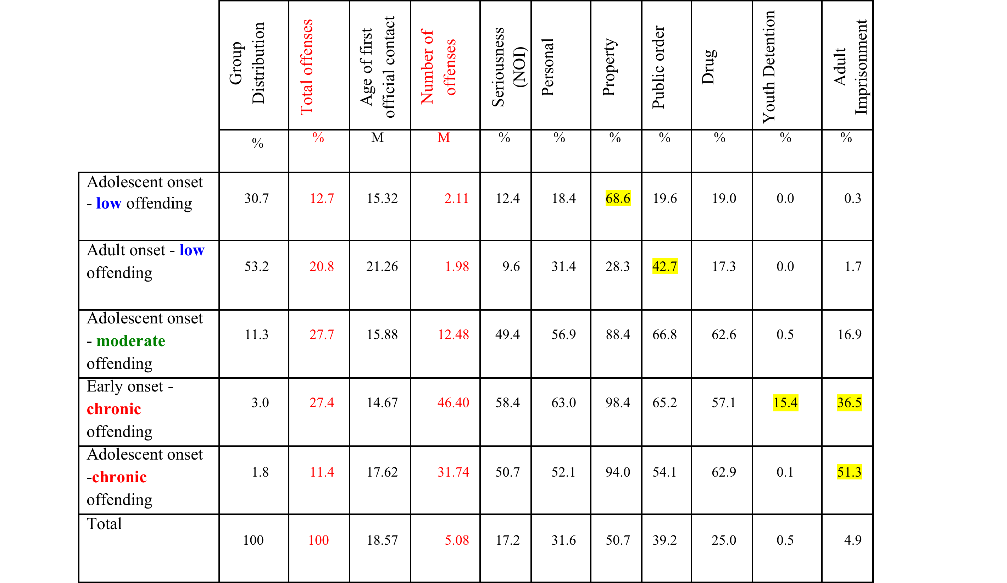
Distribution and Types of Offending

Slide 14
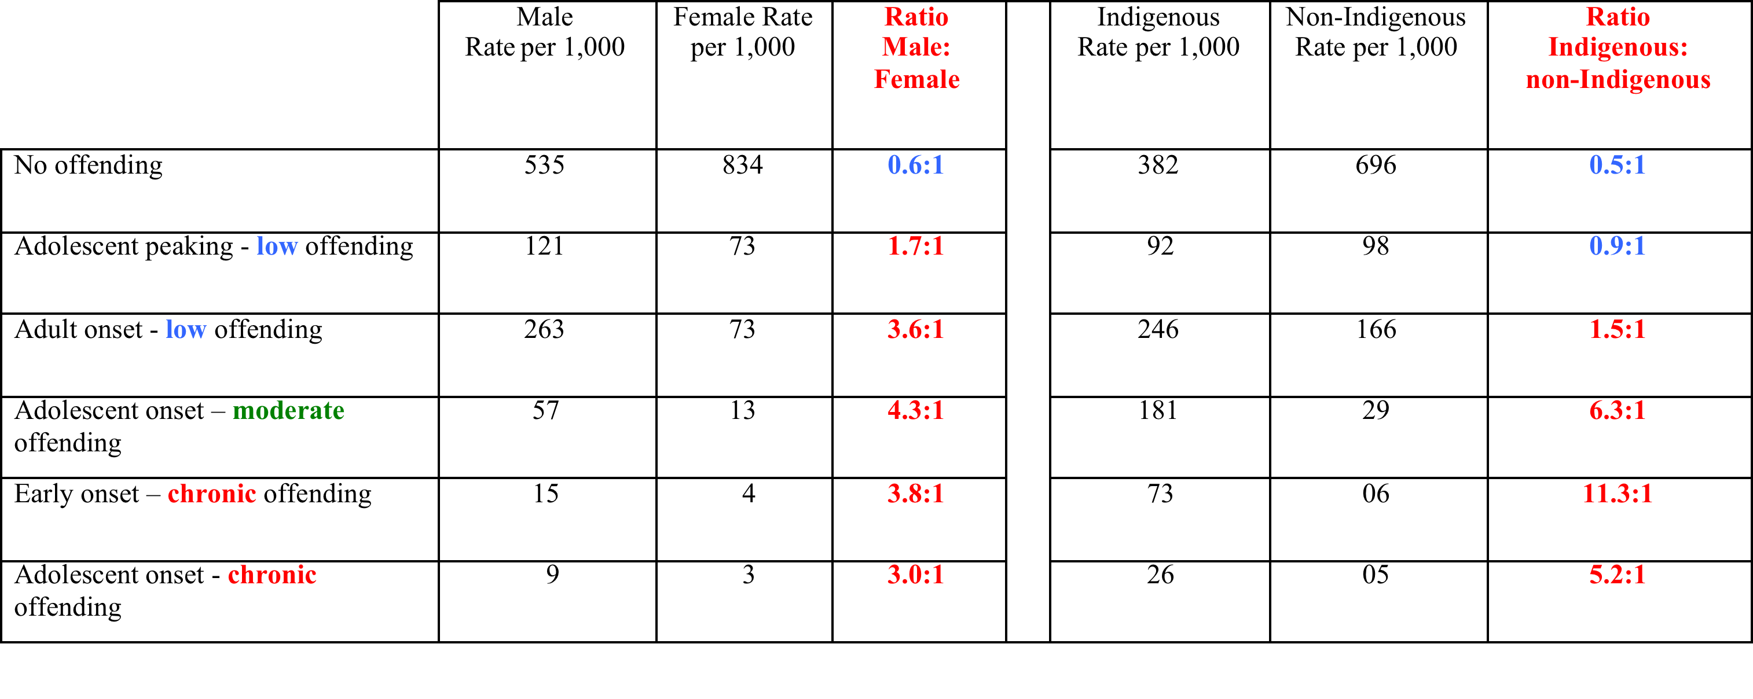
Rates of offending by groups of offenders

Slide 15
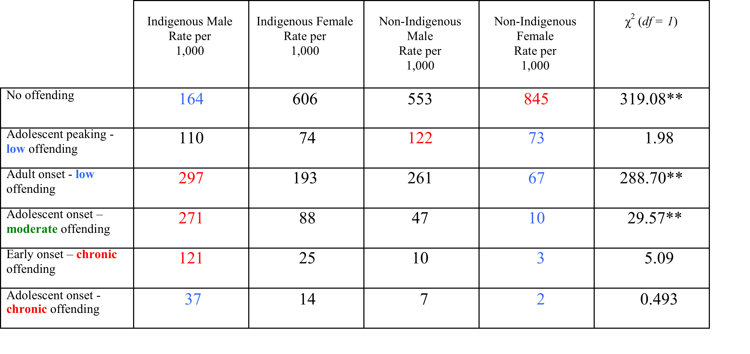
Rates of offending by groups of offenders: Intersection of Gender and Indigenous status

Slide 16
Key Conclusions
Longitudinal offending patterns in Australia generally mirror those documented with data from other developed nations
Largest group is the non-offender group—overall and for ALL subgroups except Indigenous males
      For Indigenous males, predominant groups are Adult onset—low rate offending and Adolescent onset moderate rate offending
Intersectionality matters
      Gender distributions conditioned by Indigenous status and Indigenous status distributions conditioned by gender
      BUT:
        For chronic offending, Indigenous status is the primary driver
        For low rate adolescent onset offending, gender is the primary driver

Slide 17
Key take away points—1
Need to theorize and test the structural, contextual, and individual level factors that promote risk among Indigenous Australians (both male and female)
  Literature on Indigenous disadvantage highlights the role of structural disadvantage, exposure to community and family violence, teen parents, parental incarceration, birth complications (FAS and low birth weight), alcohol and substance abuse

Slide 18
Key take away points—2
Need to theorize and test the structural, contextual, and individual level factors that promote resilience among Non-Indigenous Australian females relative to Indigenous females
      Why do Indigenous females not exhibit the same level of resilience we see among non-Indigenous females? How can we bolster resilience in Indigenous communities and among Indigenous populations?

Slide 19
Key take away points—3
Build from this to develop effective prevention and interventions across developmental stages and systems
      Cannot rely solely on early interventions—especially given relatively high rates of Adult-onset for all subgroups
      Cannot rely solely on family or individual interventions—high rates of Indigenous contact with the system suggest the import of structural and community level interventions

