Slide 1
Did the National Firearms Agreement reduce the likelihood of a gun massacre in Australia?
Lucy Snowball
Applied Research in Crime and Justice Conference
February 2019

Slide 2
Background
1996: Port Arthur massacre
35 killed and 19 injured
12 massacres in Australia since 1981
Political will to implement gun control
National Firearms Agreement
States handed over power to make gun laws to the Commonwealth

Slide 3
What was the National Firearms Agreement?
Change in reasons for licensing – ‘genuine need’
Disqualification of classes of people
Waiting period – 28 days
Ban on many automatic, self-loading and/or semi-automatic firearms
Storage and Ammunition restrictions
Australian gun laws went from ‘relatively lenient’ to ‘tough’

Slide 4
Gun buyback
Largest destruction of civilian firearms from 1991 to 2006 globally
640,000 guns bought back Oct 1996 – September 1997
60,000 handed in without compensation
One fifth of the Australian stock
Number of household with a gun 15% (1992) to 8% (2000)
$304 million (buyback) + $60 million (public awareness)
Special levy

Slide 5
Evaluation of the legislation – What was its aim?
Not about reducing single death homicides or suicides
To reduce the likelihood of a gun massacre
“Now I don’t pretend for a moment ladies and gentlemen that the decision that we have taken is going to guarantee that in the future there won’t be other mass murders. I don’t pretend that for a moment. What I do argue to you my friends is that it will significantly reduce the likelihood of those occurring in the future” (Howard, PM).

Slide 6
Has it been successful?
Majority of previous studies focused on trends in homicides and suicides
Mixture of results
Possibly attributed to differences in:
Methodology
Start and finish dates
Only one quantitative study to date used massacre series
Comparison of Australia and NZ
Methodology inappropriate and ignored 1997 massacre in NZ
Concluded no impact – concern around validity
Australian experience is cited in global gun debates
Difficult to evaluate

Slide 7
Why has this intervention been hard to evaluate?
Low count time series
Rare event
Up until recently no ‘events’ in post period
No clear methodology
No comparison group

Slide 8
Aim of current study
Test whether the NFA has reduced the likelihood of a gun massacre
Sensitivity testing through different:
Definitions of a massacre
Start of time series
Methodologies

Slide 9
Definition of a massacre
Two definitions in literature:
National Homicide Monitoring Program (used in McPhedran & Baker, 2011):
4+ victims
24 hour period
Single shooter
Chapman study:
5+ victims
Any time period
Single or multiple shooters

Slide 10
Massacre dataset
Date | Location | Number killed by firearm | Chapman et al. (2006) | McPhedran & Baker (2011)
6 September 1971 | Hope Forest, SA | 10 | N | N
24 September 1981 | Campsie, NSW | 5 | Y | Y
1 June 1984 | Wahroonga, NSW | 5 | Y | Y
23 January 1987 | Pymble, NSW | 4 | N | Y
19 June 1987 | Top End, NT/WA | 5 | Y | N
9 August 1987 | Melbourne, VIC | 7 | Y | Y
10 October 1987 | Canley Vale, NSW | 5 | Y | Y
8 December 1987 | Melbourne, VIC | 8 | Y | Y
25 September 1988 | Oenpelli, NT | 6 | Y | Y
30 August 1990 | Surry Hills, NSW | 5 | Y | Y
17 August 1991 | Strathfield, NSW | 6 | Y | Y
27 October 1992 | Terrigal, NSW | 6 | Y | Y
31 March 1993 | Cangai, NSW | 5 | Y | N
25 January 1996 | Hillcrest, QLD | 6 | Y | Y
28 April 1996 | Port Arthur, TAS | 35 | Y | Y
8/9 September 2014 | Watch Hill, NSW | 4 | N | N
Total |  |  | 13 | 12

Slide 11
Methodology
Fisher’s Exact Test
A non-parametric test that can determine whether there is an association between two categorical variables
Likelihood Ratio test
Geometric distribution (time between events)
Generalised linear modelling
Geometric distribution (number of failures before a success)

Slide 12
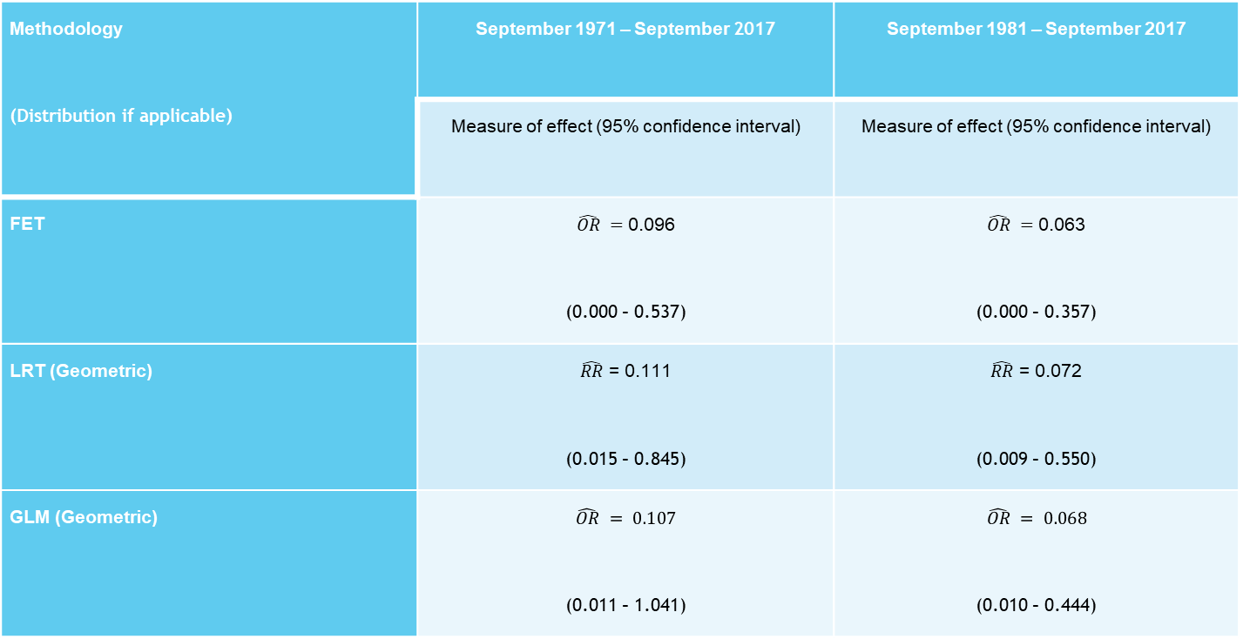
Results
Methodology (Distribution if applicable) | September 1971 – September 2017 | September 1981 – September 2017
 | Measure of effect (95% confidence interval) | Measure of effect (95% confidence interval)
FET | $\hat{OR} =$0.096 (0.000 – 0.537) | $\hat{OR} =$0.063 (0.000 – 0.357)
LRT (Geometric) | $\hat{RR}$ = 0.111 (0.015 – 0.845) | $\hat{RR}$ = 0.072 (0.009 – 0.550)
GLM (Geometric) | $$\hat{OR} = 0.107$$ (0.011 – 1.041) | $$\hat{OR} = 0.068$$ (0.010 – 0.444)

Slide 13
What do the results show?
Odds ratio and relative risk estimates are approximately 0.10
Irrespective of analytic method used or starting date
Confidence intervals are wide around all point estimates due to the small number of observations over a long period.
Upper confidence intervals ~ 0.5
Significant at 10% or 5%

Slide 14
What conclusions can be drawn?
Correlative relationship and not causation
Scarcity of data suggests results should be treated with caution
All three methodologies suggest a reduction in likelihood of 90%
No evidence to suggest NFA has been a failure

